Slide 1
FIT CFMM MPS Curriculum Mapping
The Process:
Academic Program Review/ Self-Study Assessment
Review of mission, curriculum and learning outcomes from each course of study/syllabi with faculty
Determination of major learning outcomes (MLO)
Determination of which courses that applied (in sequence) to each MLO

Slide 2
FIT CFMM MPS Curriculum Mapping
The Process:
Intuitive
Inclusive
Interdependent
Interdisciplinary

Slide 3
FIT CFMM MPS Curriculum Mapping
The Process:
Intuitive – connecting program learning outcomes to individual course learning outcomes
Inclusive – faculty review of course syllabi learning outcomes and connection to overall program learning outcomes
Interdependent – learning outcomes, hard & soft skills needed to succeed in industry are continually built throughout the program
Interdisciplinary – allows identification of interdisciplinary projects to further enhance MLO’s

Slide 4
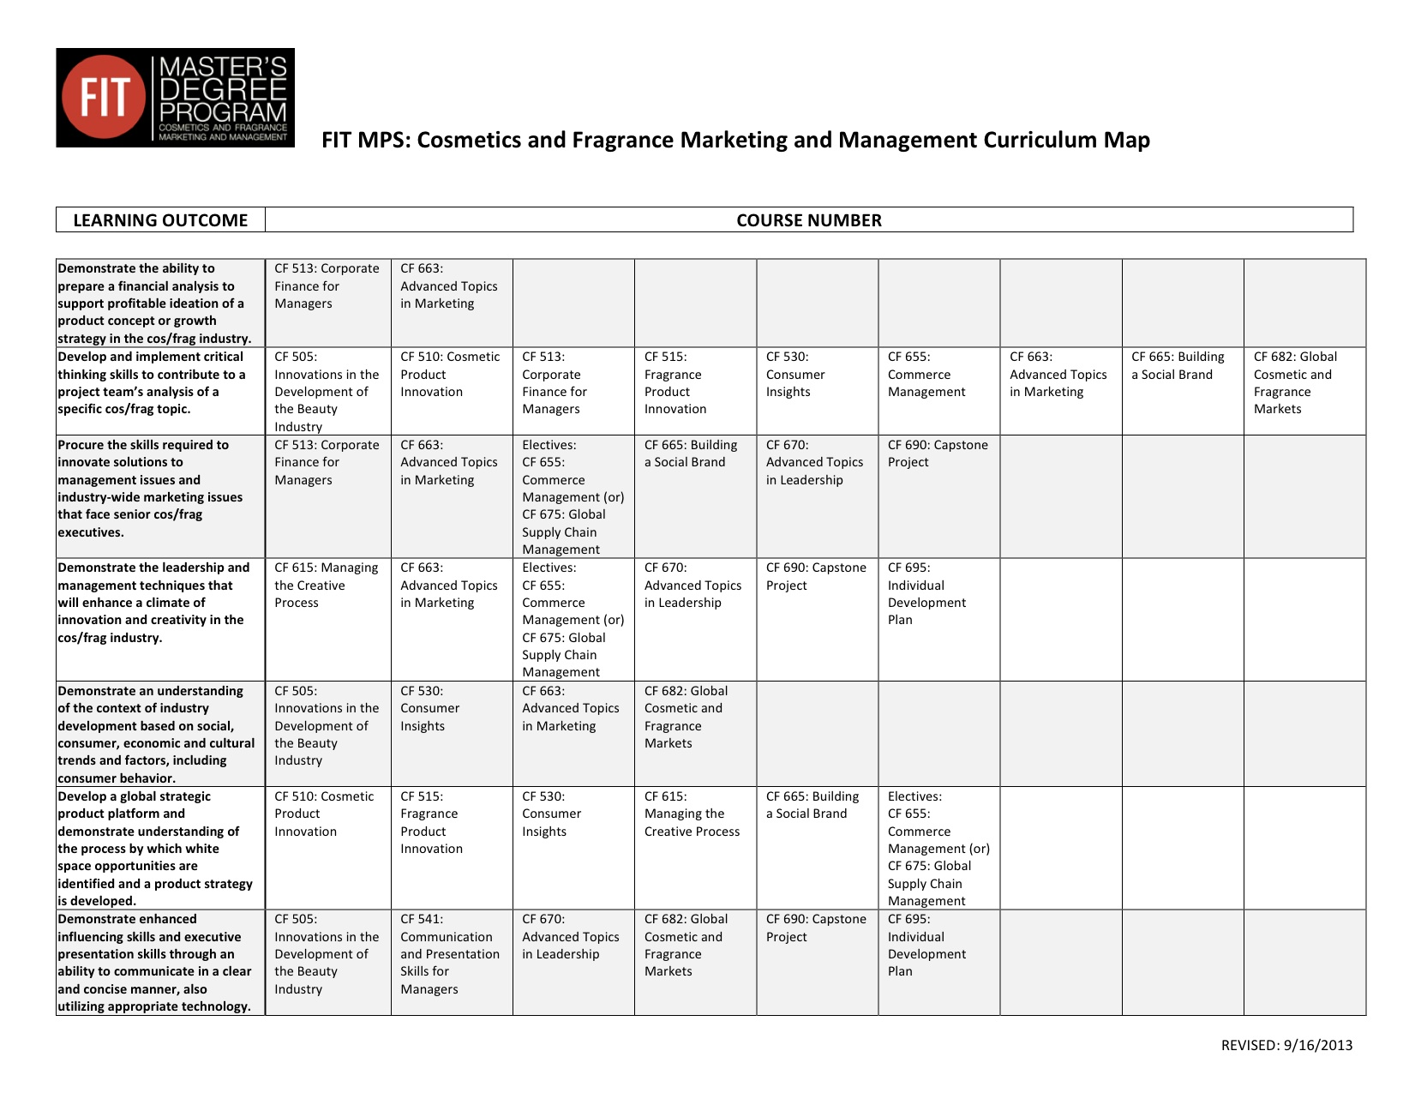

Slide 5
FIT CFMM MPS Curriculum Mapping
Example: MLO #2
Develop and implement critical thinking skills to contribute to a project team’s analysis of a specific cosmetic/fragrance topic.
CF505 Innovations in the Development of the Beauty Industry
CF510 Cosmetic Product Innovation
CF513 Corporate Finance for Managers
CF515 Fragrance Product Innovation
CF530 Consumer Insights
CF655 Commerce Management
CF663 Advanced Topics in Marketing
CF655 Building a Social Brand
CF682 Global Cosmetic Fragrance Markets

Slide 6
FIT CFMM MPS Curriculum Mapping
The End Result: A clearly defined roadmap for success
that benefits all stakeholders
Current Students
Prospective Students
Recruitment Efforts
Faculty
Corporate Partners/Industry
Guest Speakers/Workshops
Alumni
FIT Curriculum Committee
FIT Administration, Assessment, Accreditation
FIT School of Graduate Studies & other programs

