Slide 1
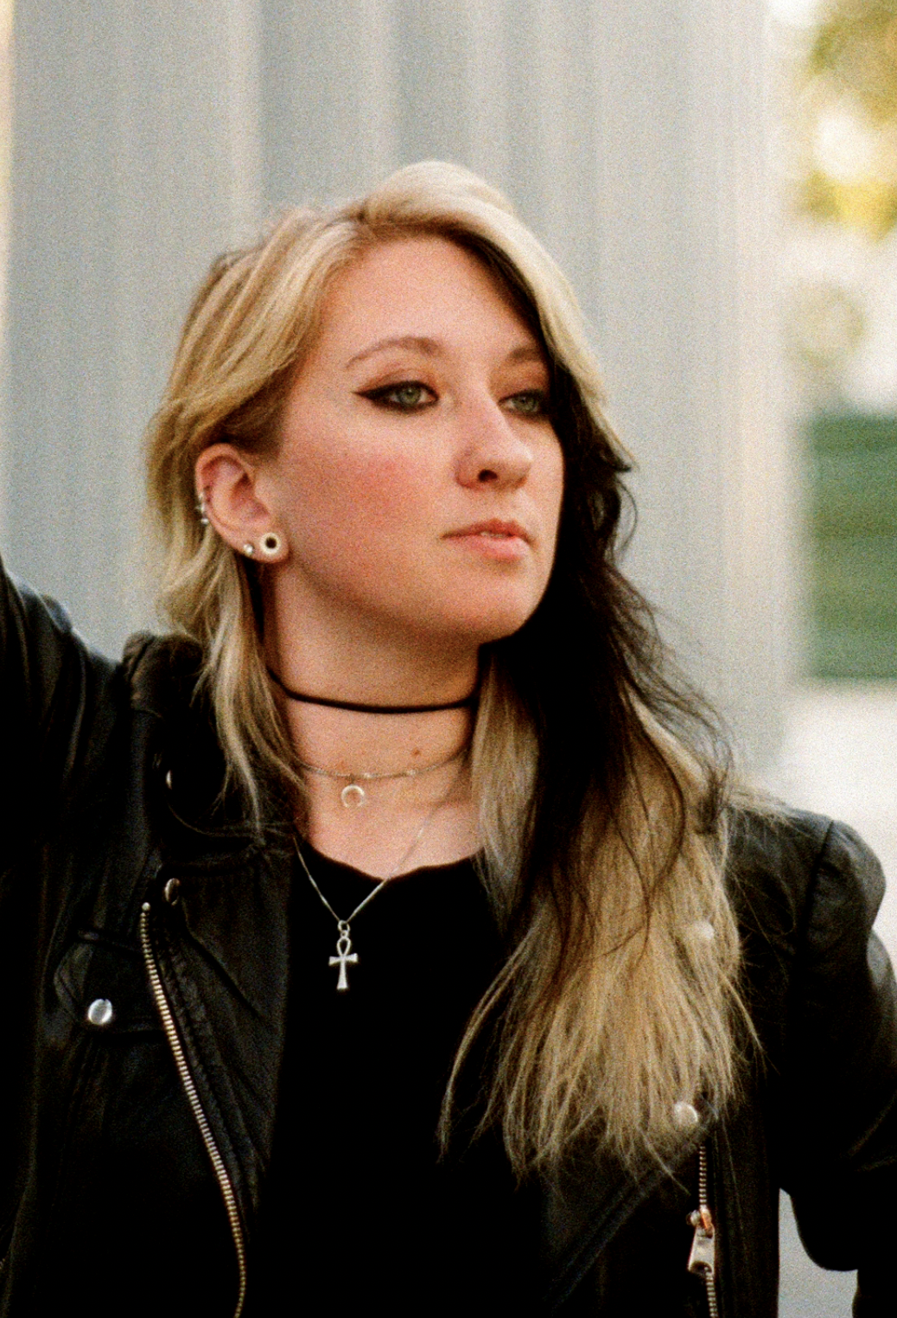
Rinn Wight
Hailing from Long Island New York, Rinn is an illustrator who’s passion for crafting visual narratives started at a young age,
initially discovering this passion at Warped Tour 2009; through the raw emotion of a band pouring their hearts out and the
collective response of a crowd echoing back. Witnessing how music can unify people and resonate with millions sparked a deep desire within her to be a part of that connection.
The visual elements and branding associated with music go beyond mere design; they link an artist and their audience. The imagery accompanying a musical narrative has the power to strengthen the bond between creator and listener, enhancing the overall experience. Musicians create songs that people can relate to, understand on an emotional level, and tell a narrative we, as listeners, can relate to. It is the job of an Illustrator and designer to connect this audible narrative to visuals.
Rinn currently resides in a shoebox located in the heart of Bushwick, Brooklyn, sharing her creative sanctuary with her partner, Bryan, and their Siberian Husky, Klaus. When she’s not tackling a project, she can be found in the pit at a live show or getting competitive at her local trivia night.
RinnWight.com
@RinnWight
Photo/Headshot

Slide 2
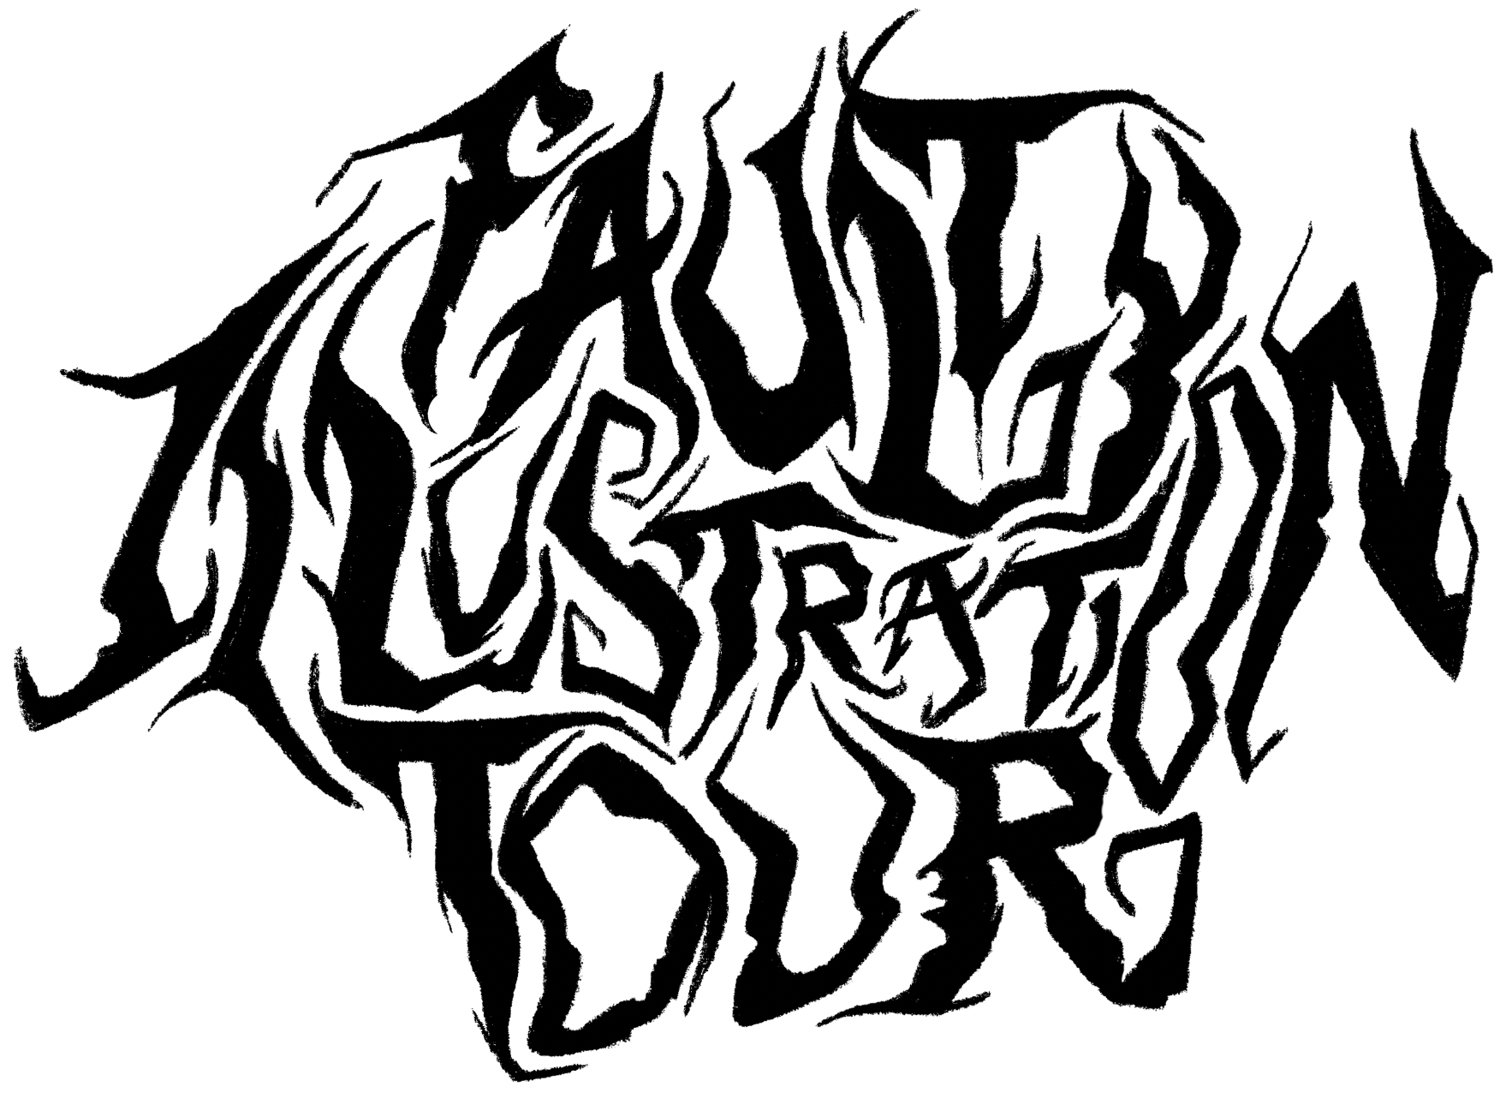
Faulty Illustration Tour
The visual elements and branding associated with music go beyond mere design; they link an artist and their audience. The imagery accompanying a musical narrative has the power to strengthen the bond between creator and listener, enhancing the overall experience. Musicians create songs that people can relate to, understand on an emotional level, and tell a narrative we, as listeners, can relate to.
I have been captivated by narratives from a young age, initially discovering this passion at Warped Tour (2009) through the raw emotion of several bands pouring their hearts out and the collective response of a crowd echoing back. Witnessing how music can unify people and resonate with millions sparked my deep desire to be a part of that connection.
This collection of various albums is not only a testament to a song, album, or the narratives woven by the musicians but also a look into my own life and how I perceived experiences that shaped me. As we all perceive music, lyrics, and sounds differently, I encourage you to reflect on your emotions and experiences when encountering my artwork. What narrative do you hear? How does it resonate with you? Let’s uncover your unique interpretation of the visual stories before you!

Slide 3
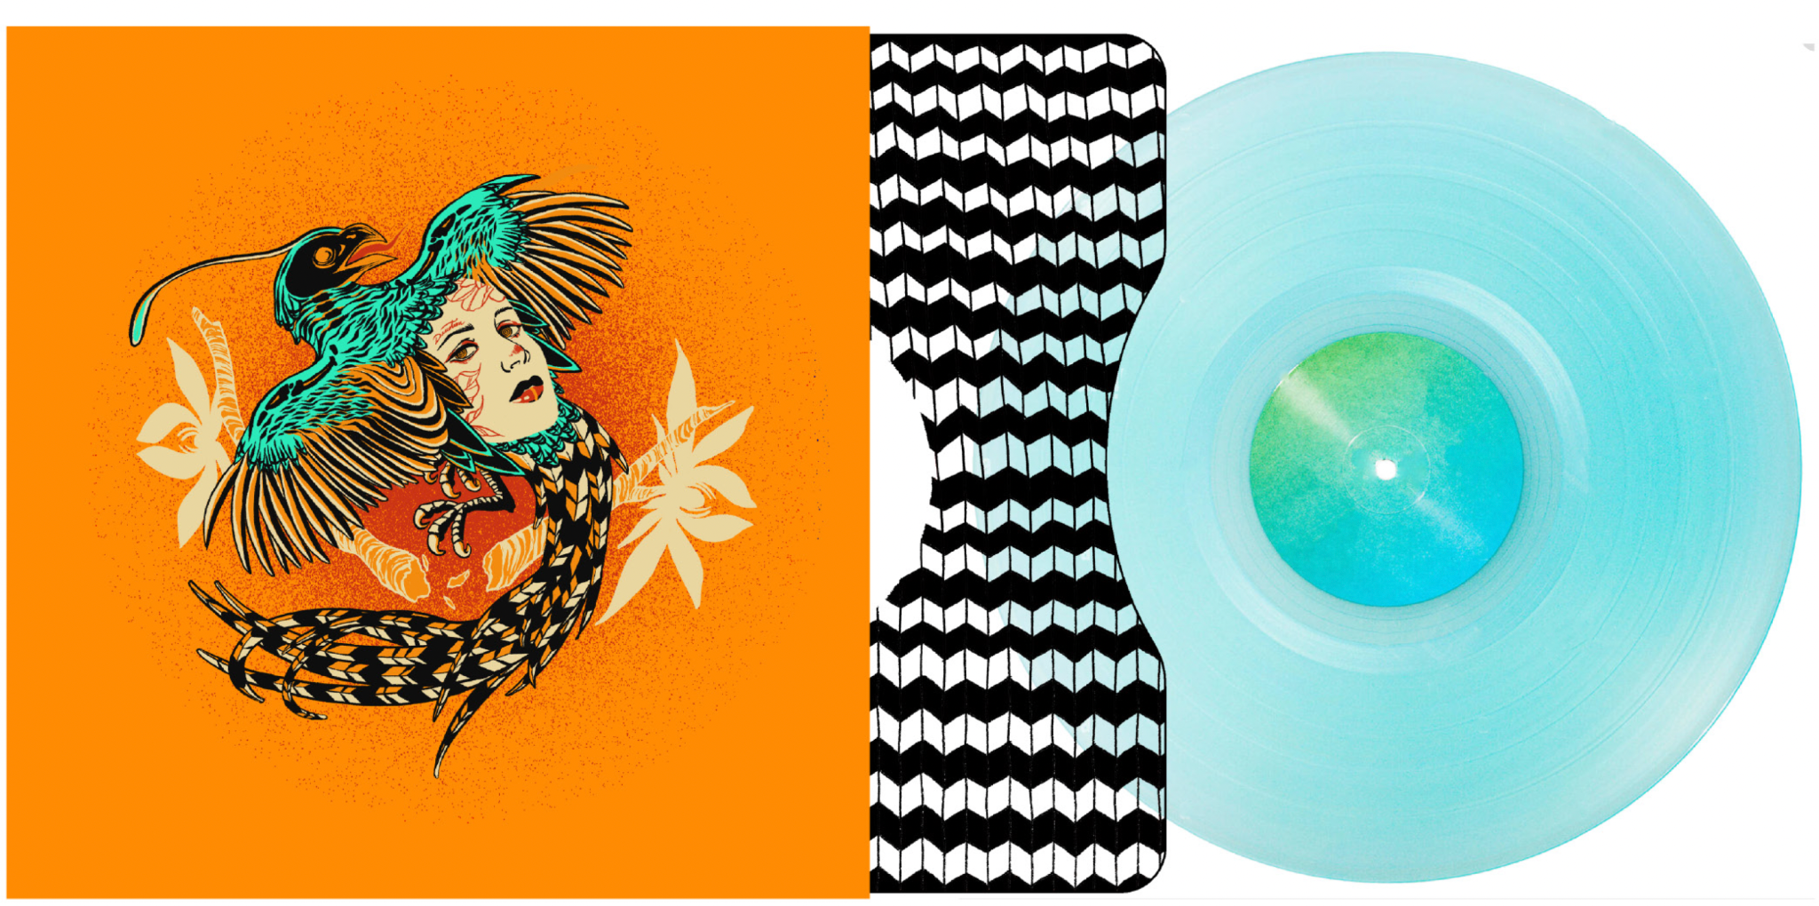
Interrobang
Digital Illustration
12” x 36”
vinyl record album

Slide 4
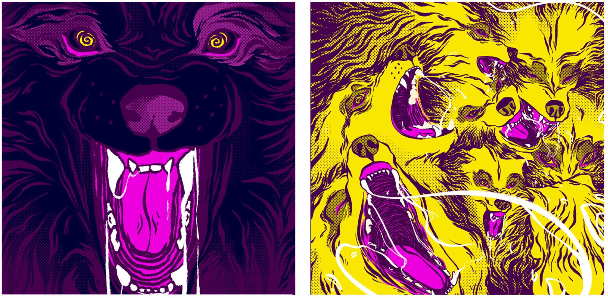
Modern Wolf Hair
Digital Illustration
12”x12”
vinyl record album

Slide 5
Vampires Will Never Hurt You
Digital Illustration
12” x 36”
Trifold vinyl record album

Slide 6
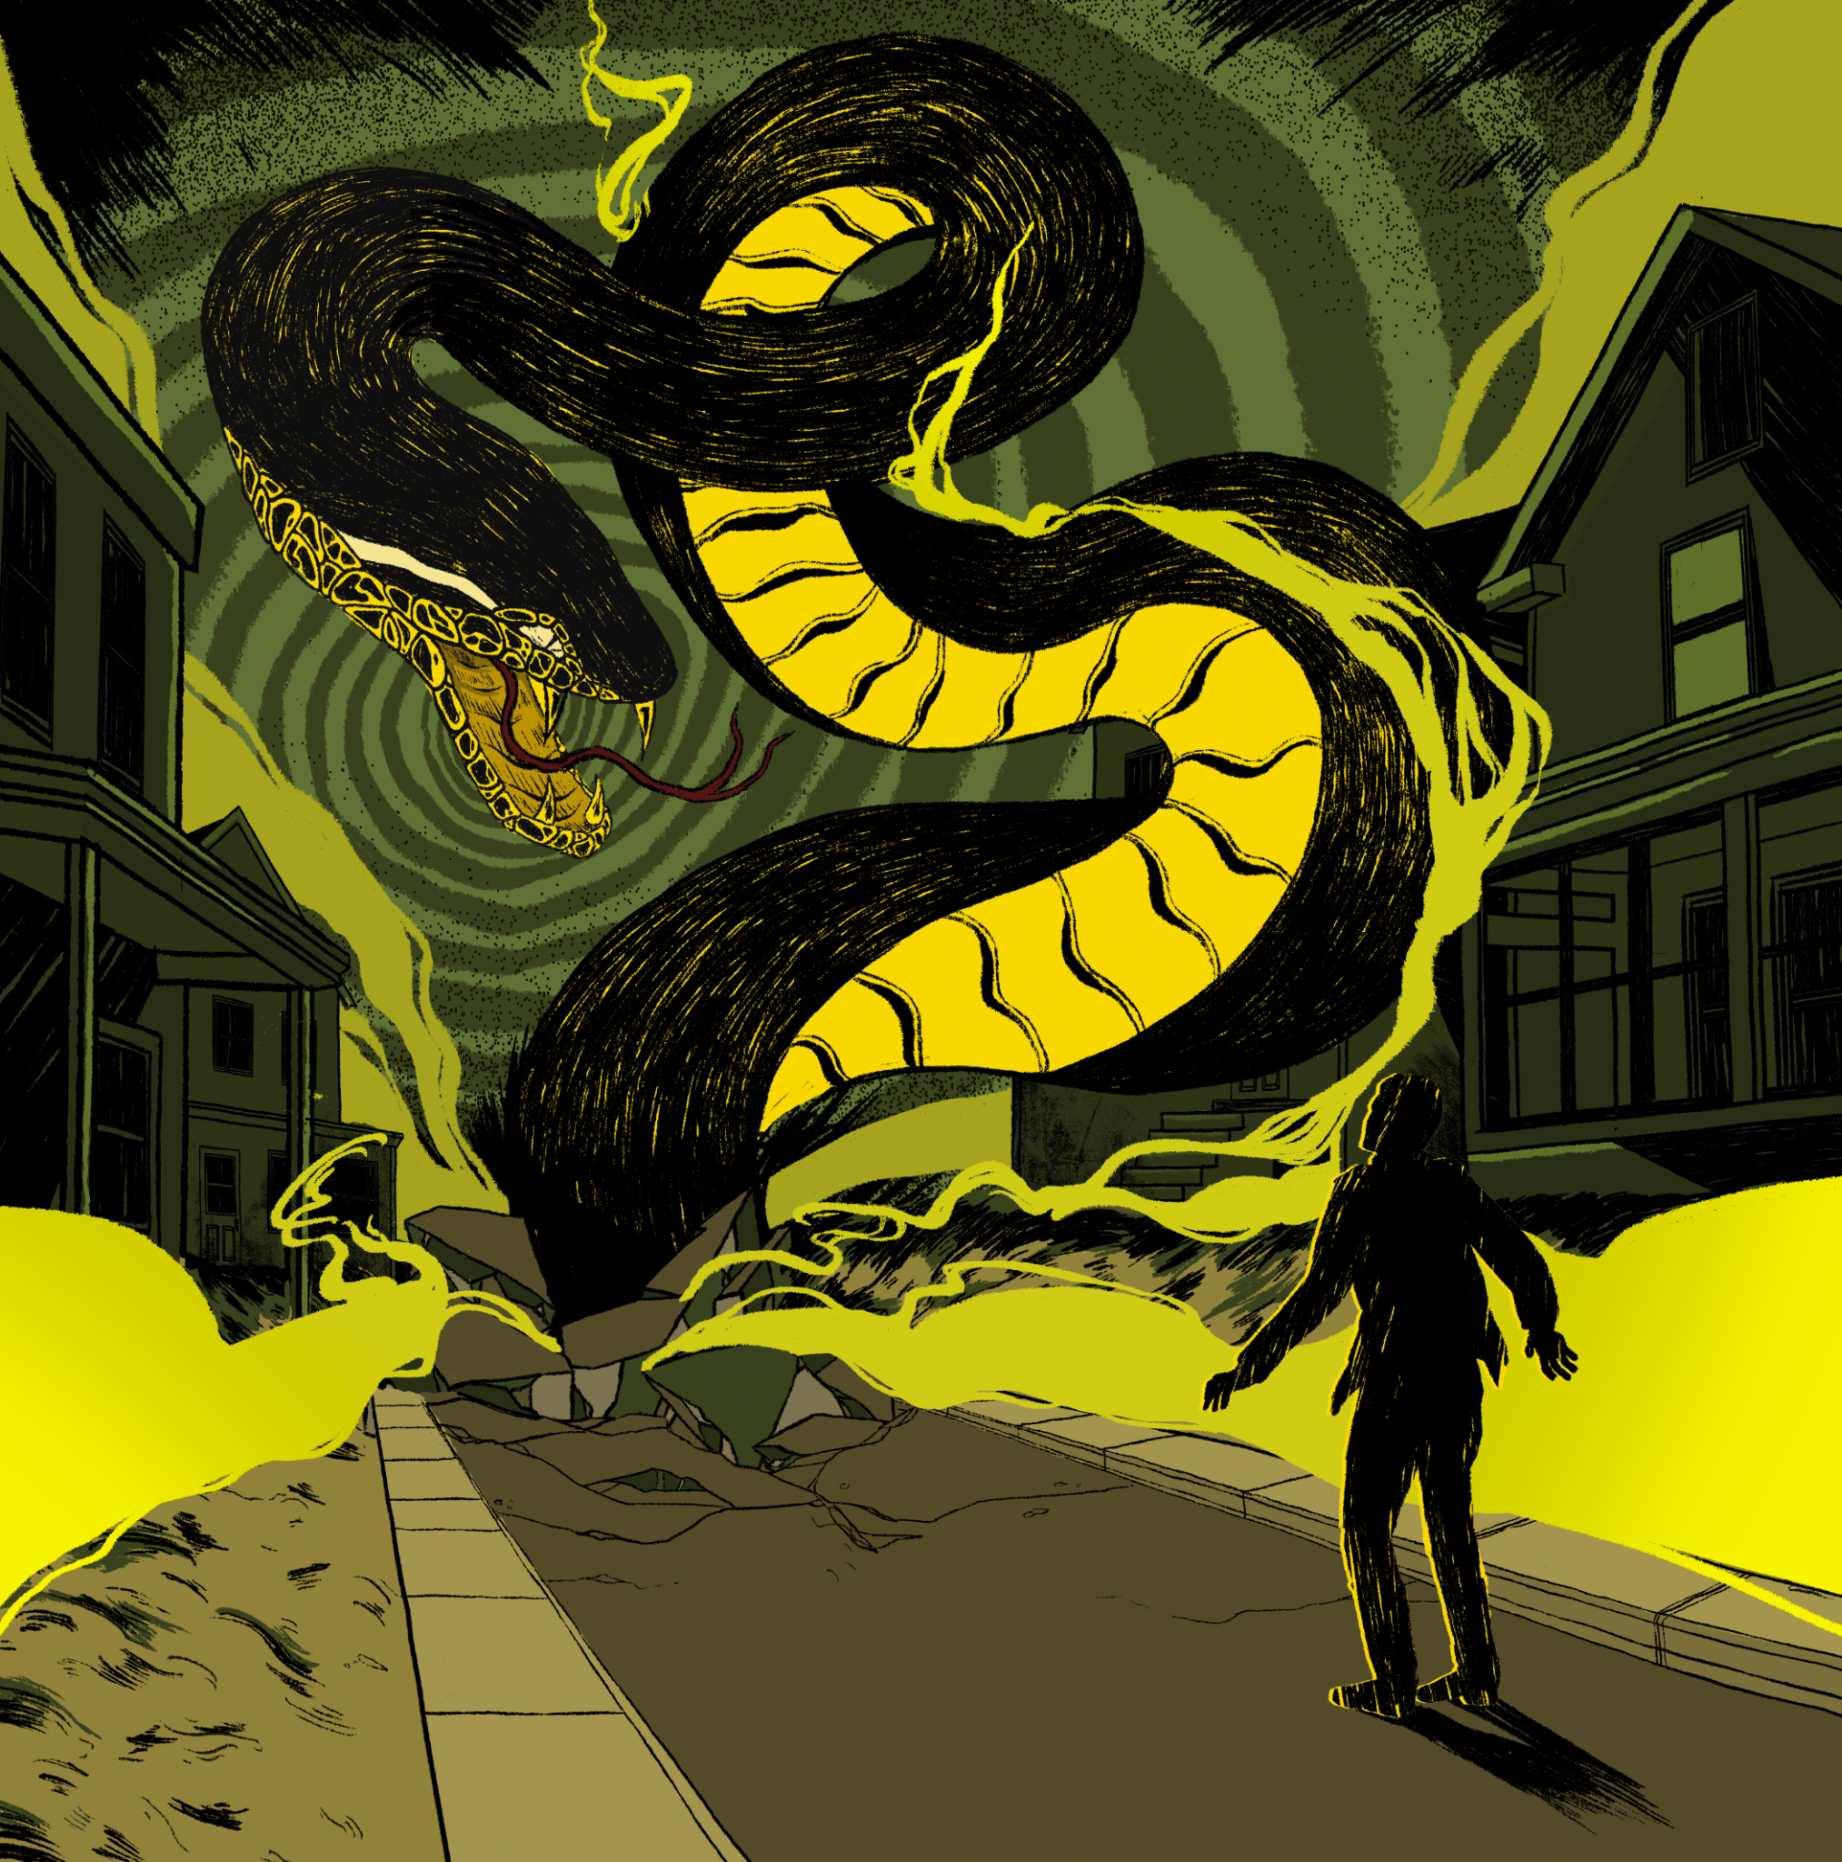
Lapse
Digital Illustration/AR
7”x7”
AR vinyl record album

Slide 7
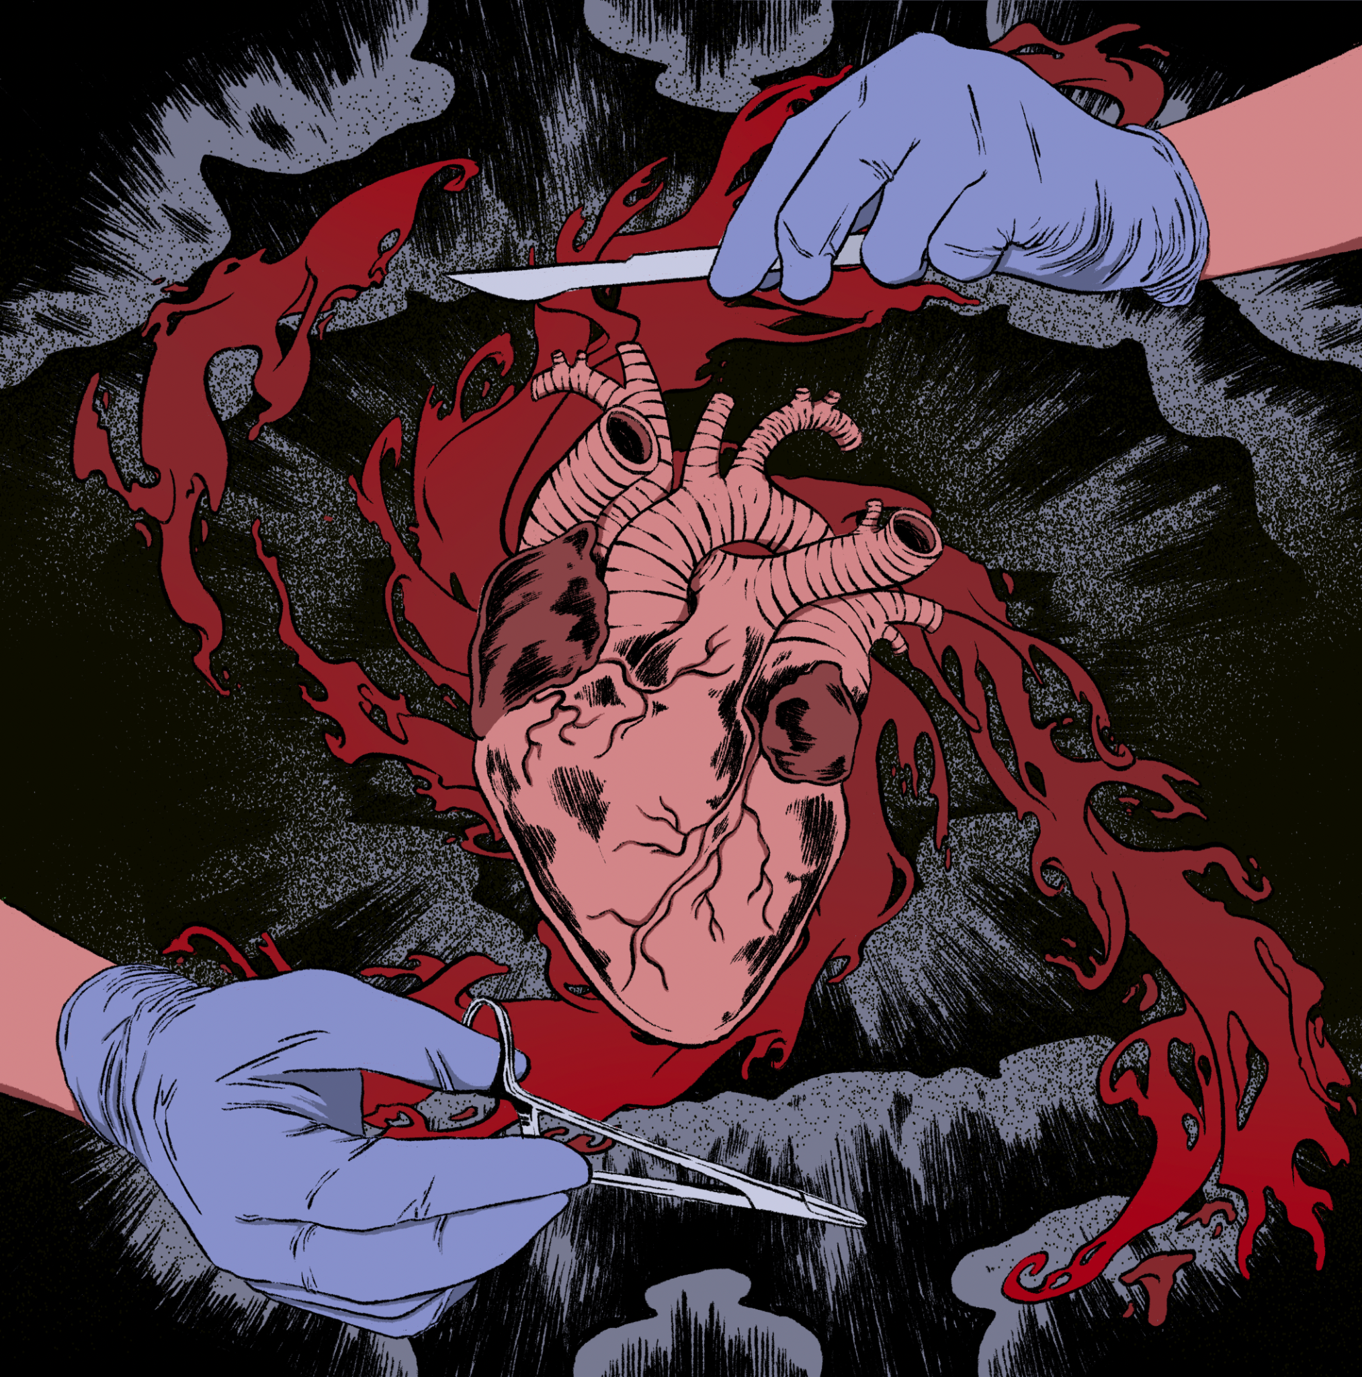
The Gift of Paralysis
Digital Illustration/AR
7”x7”
AR vinyl record album

Slide 8
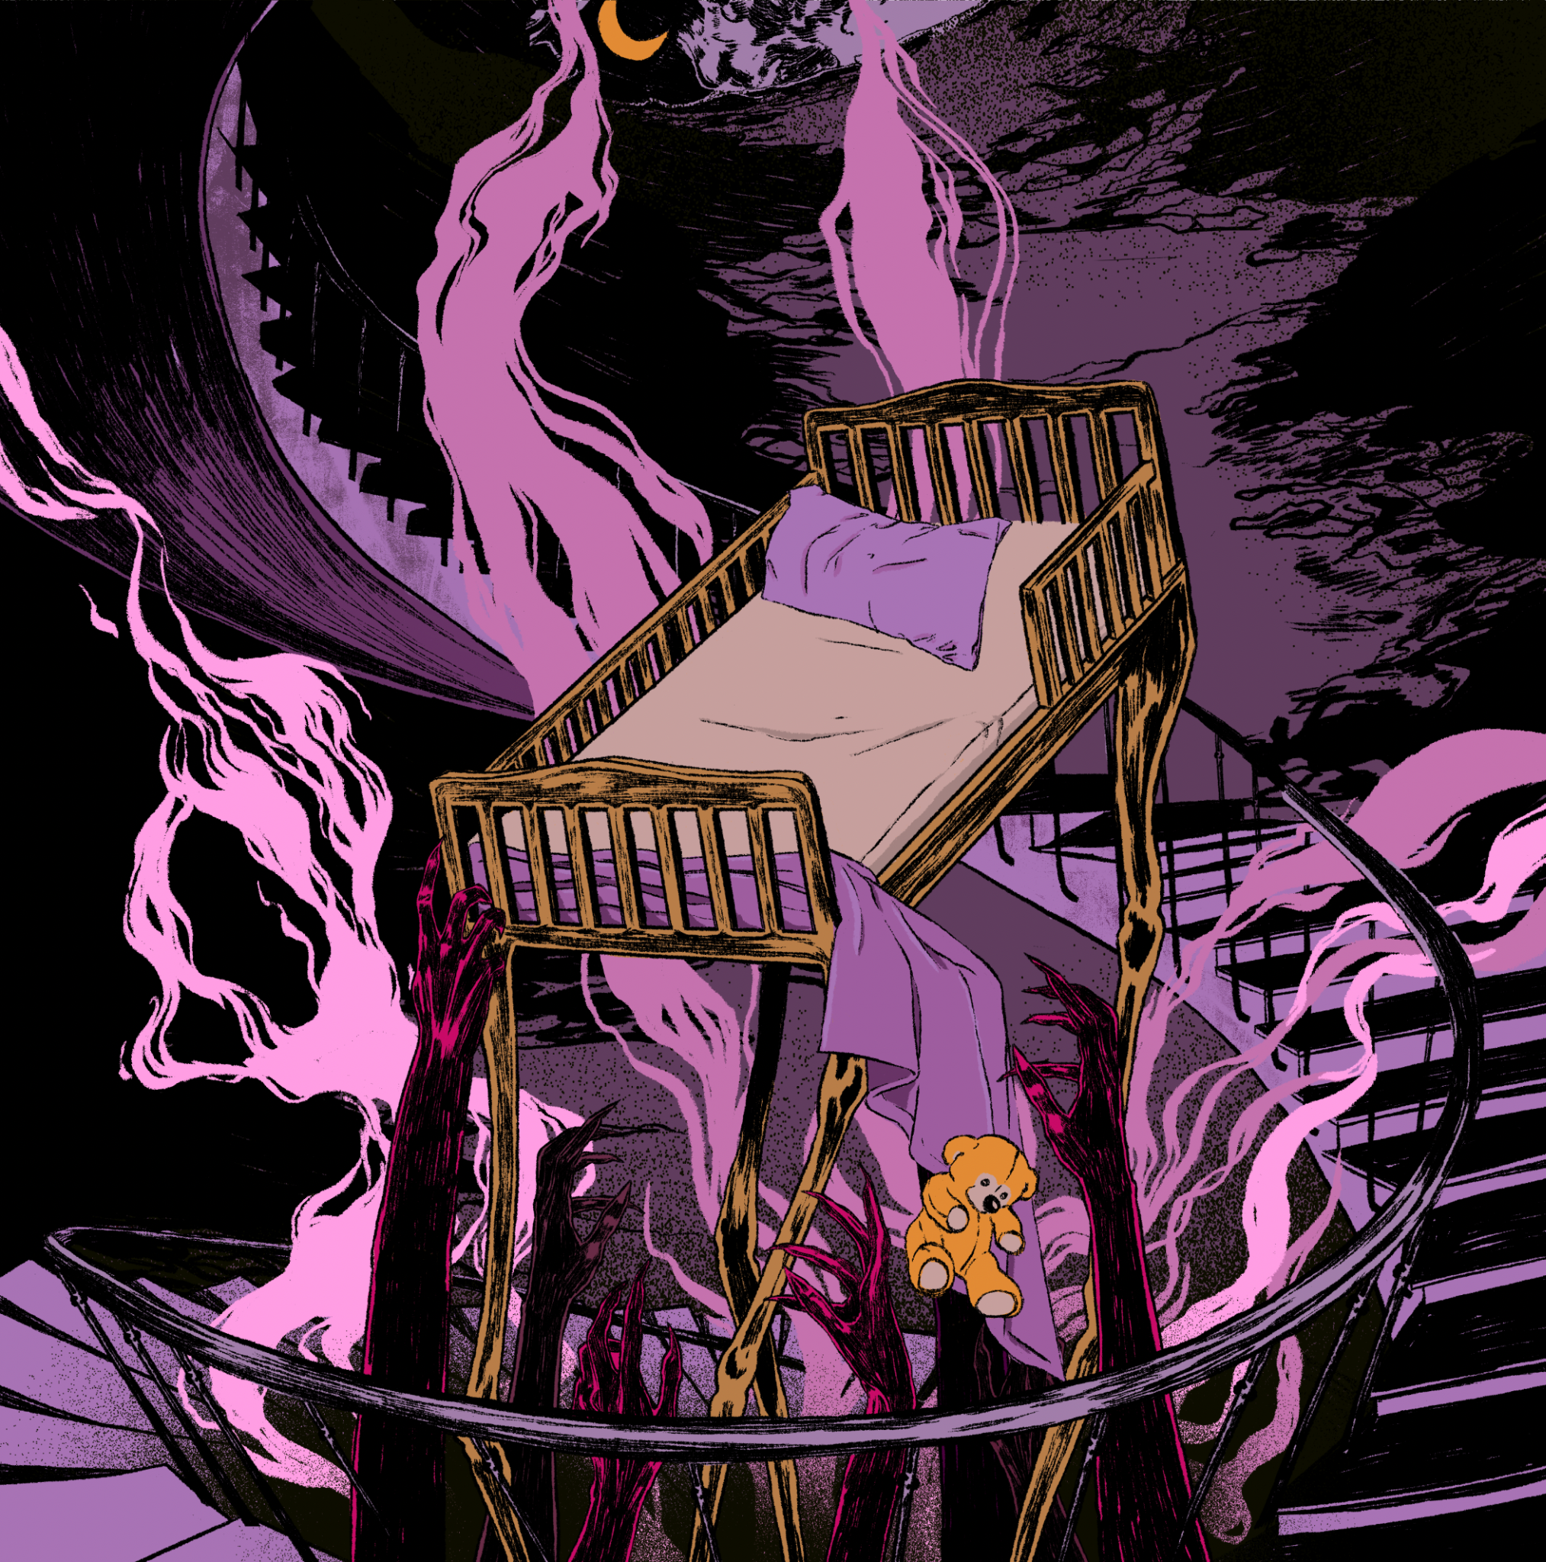
(X) Amount of Truth
Digital Illustration/AR
7”x7”
AR vinyl record album

Slide 9
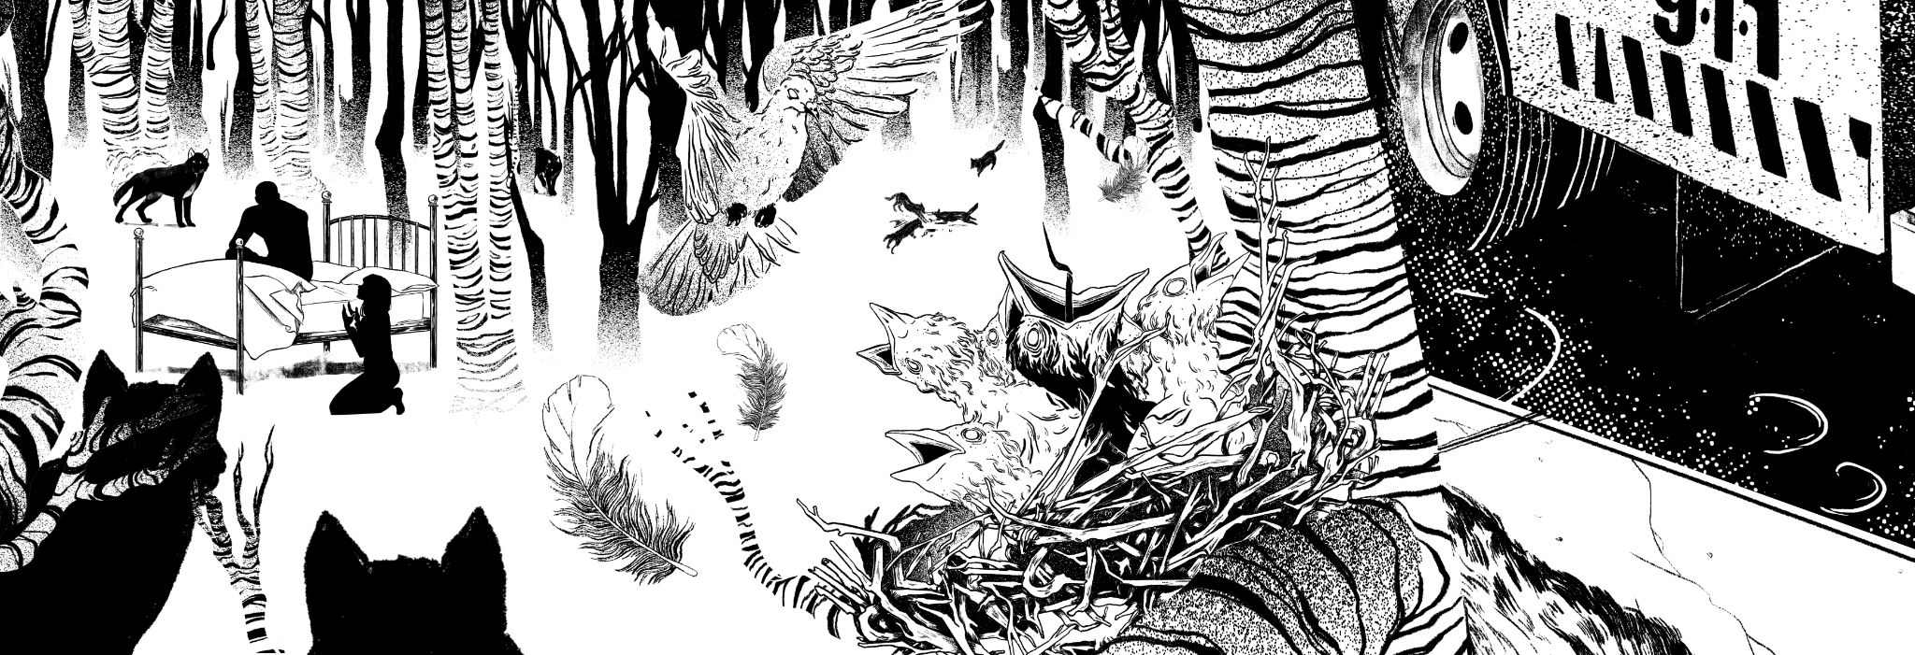
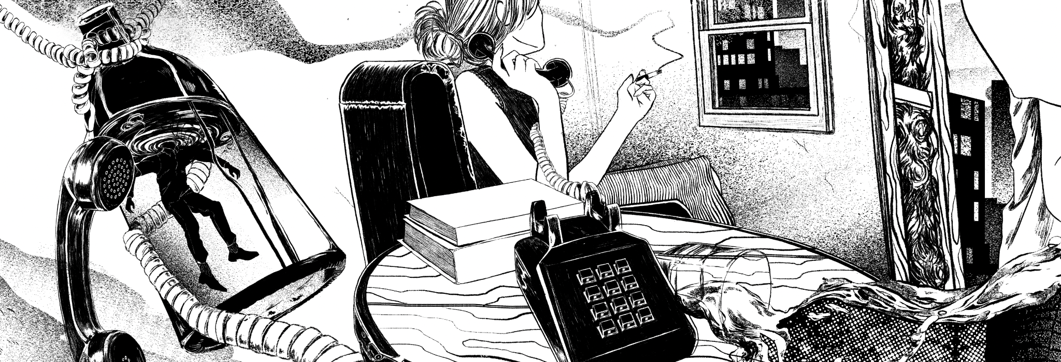
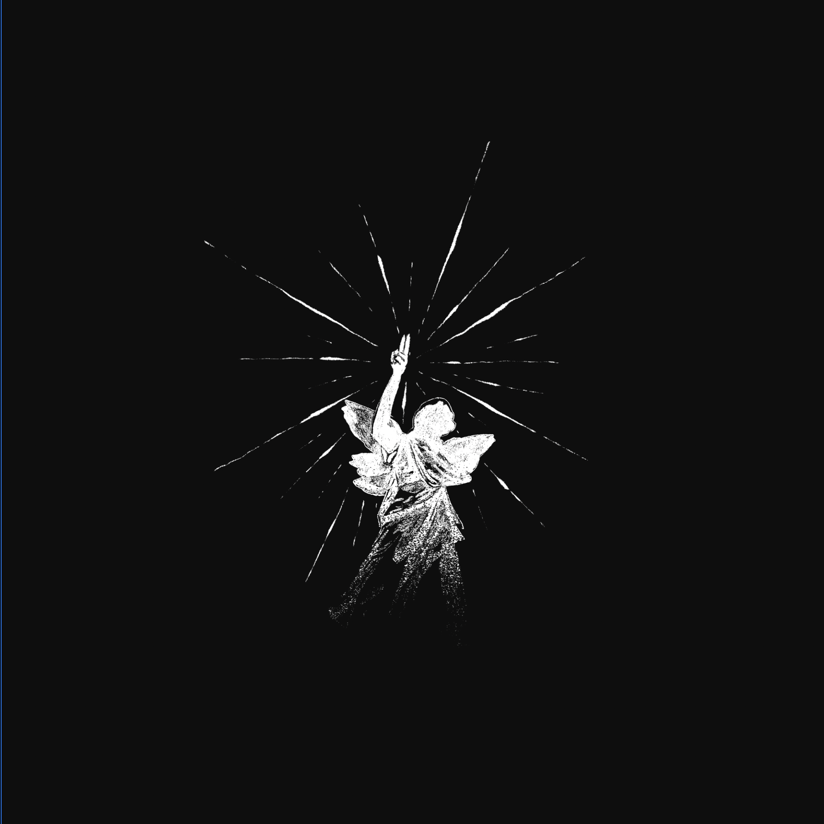
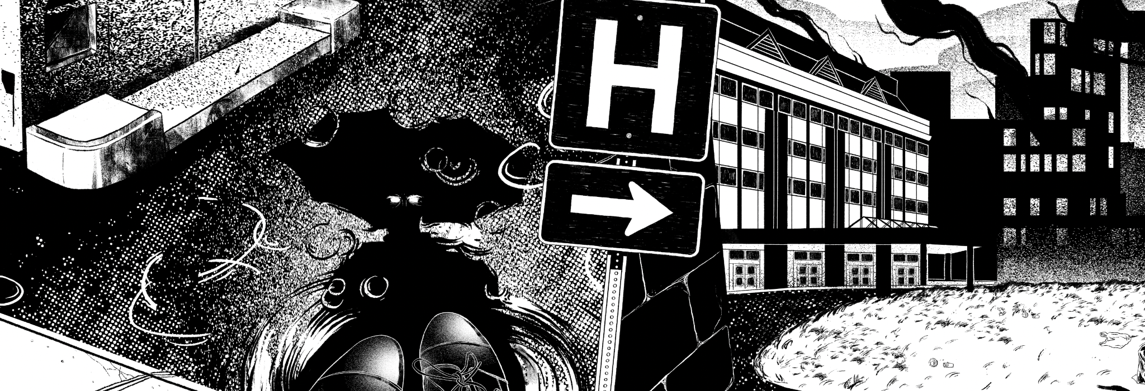
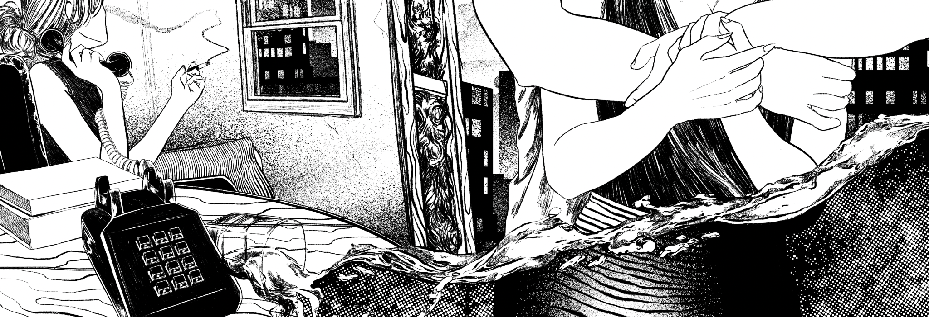
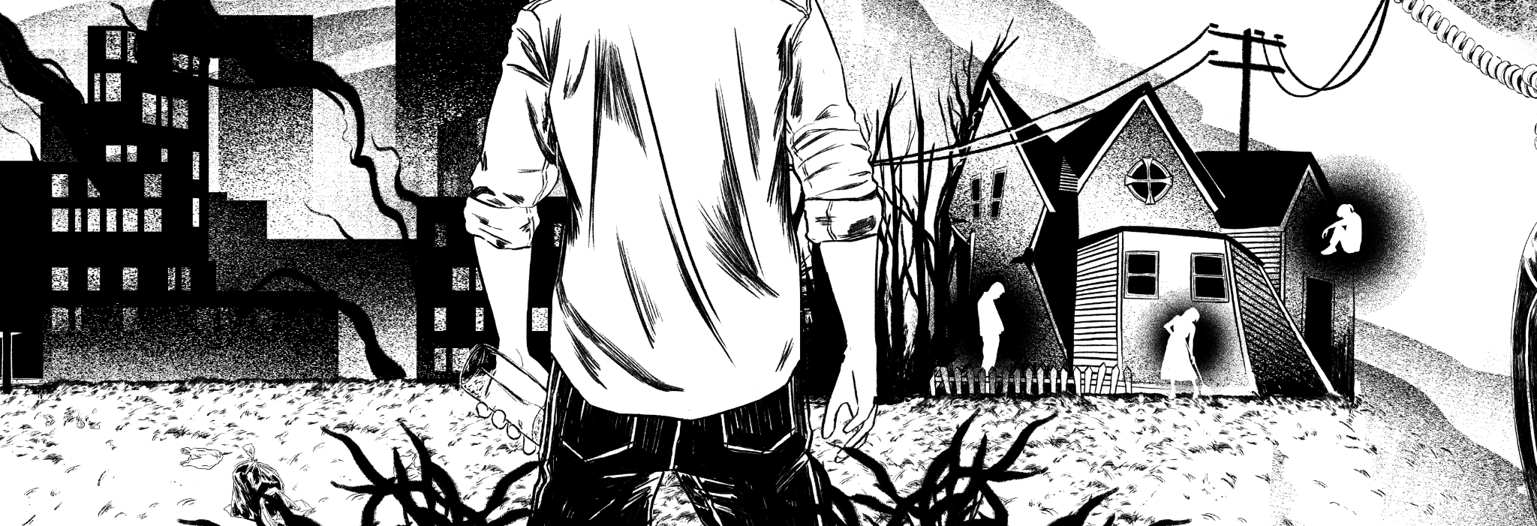
I’m Like a Virgin Losing a Child
Digital Illustration
7”x7”
AR vinyl record album

