Slide 1
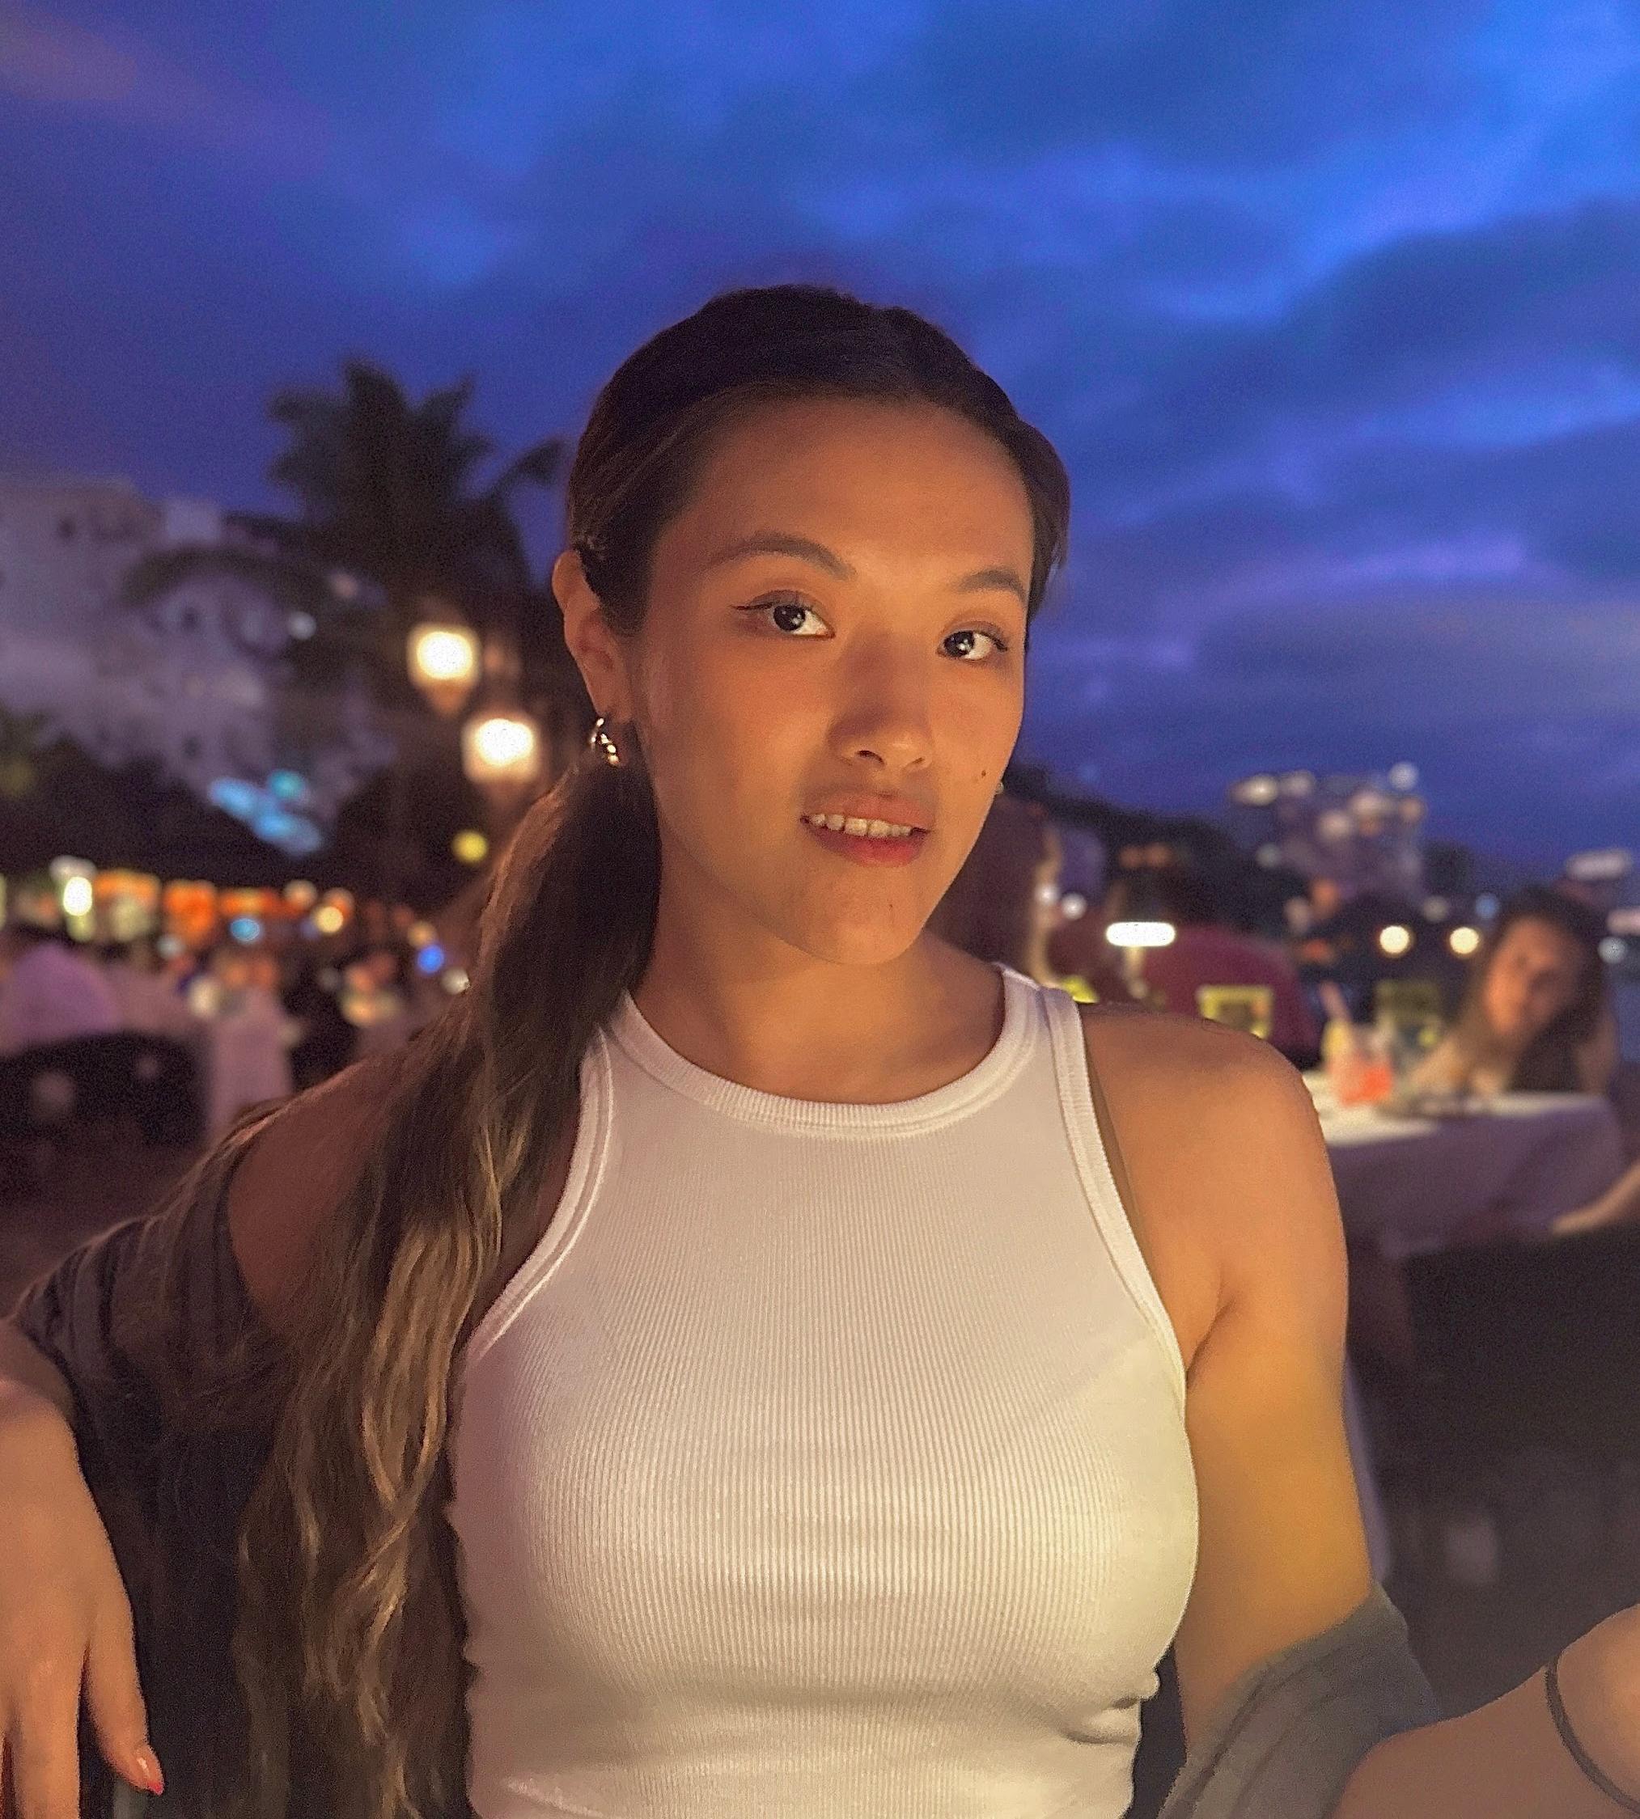
Livi Carlen
Livi Carlen is a New York based illustrator and graphic designer. Her art reflects on the playful, emotional and nostalgic moments in life, through stories about coming of age and relationships with ourselves and the world. Carlen always aims to create a welcoming environment for viewers by inspiring curiosity and feelings within people through colorful and lively illustrations.
livicarlen.com
IG: @livienrose_
livicarlen.design@gmail.com
Photo/Headshot

Slide 2
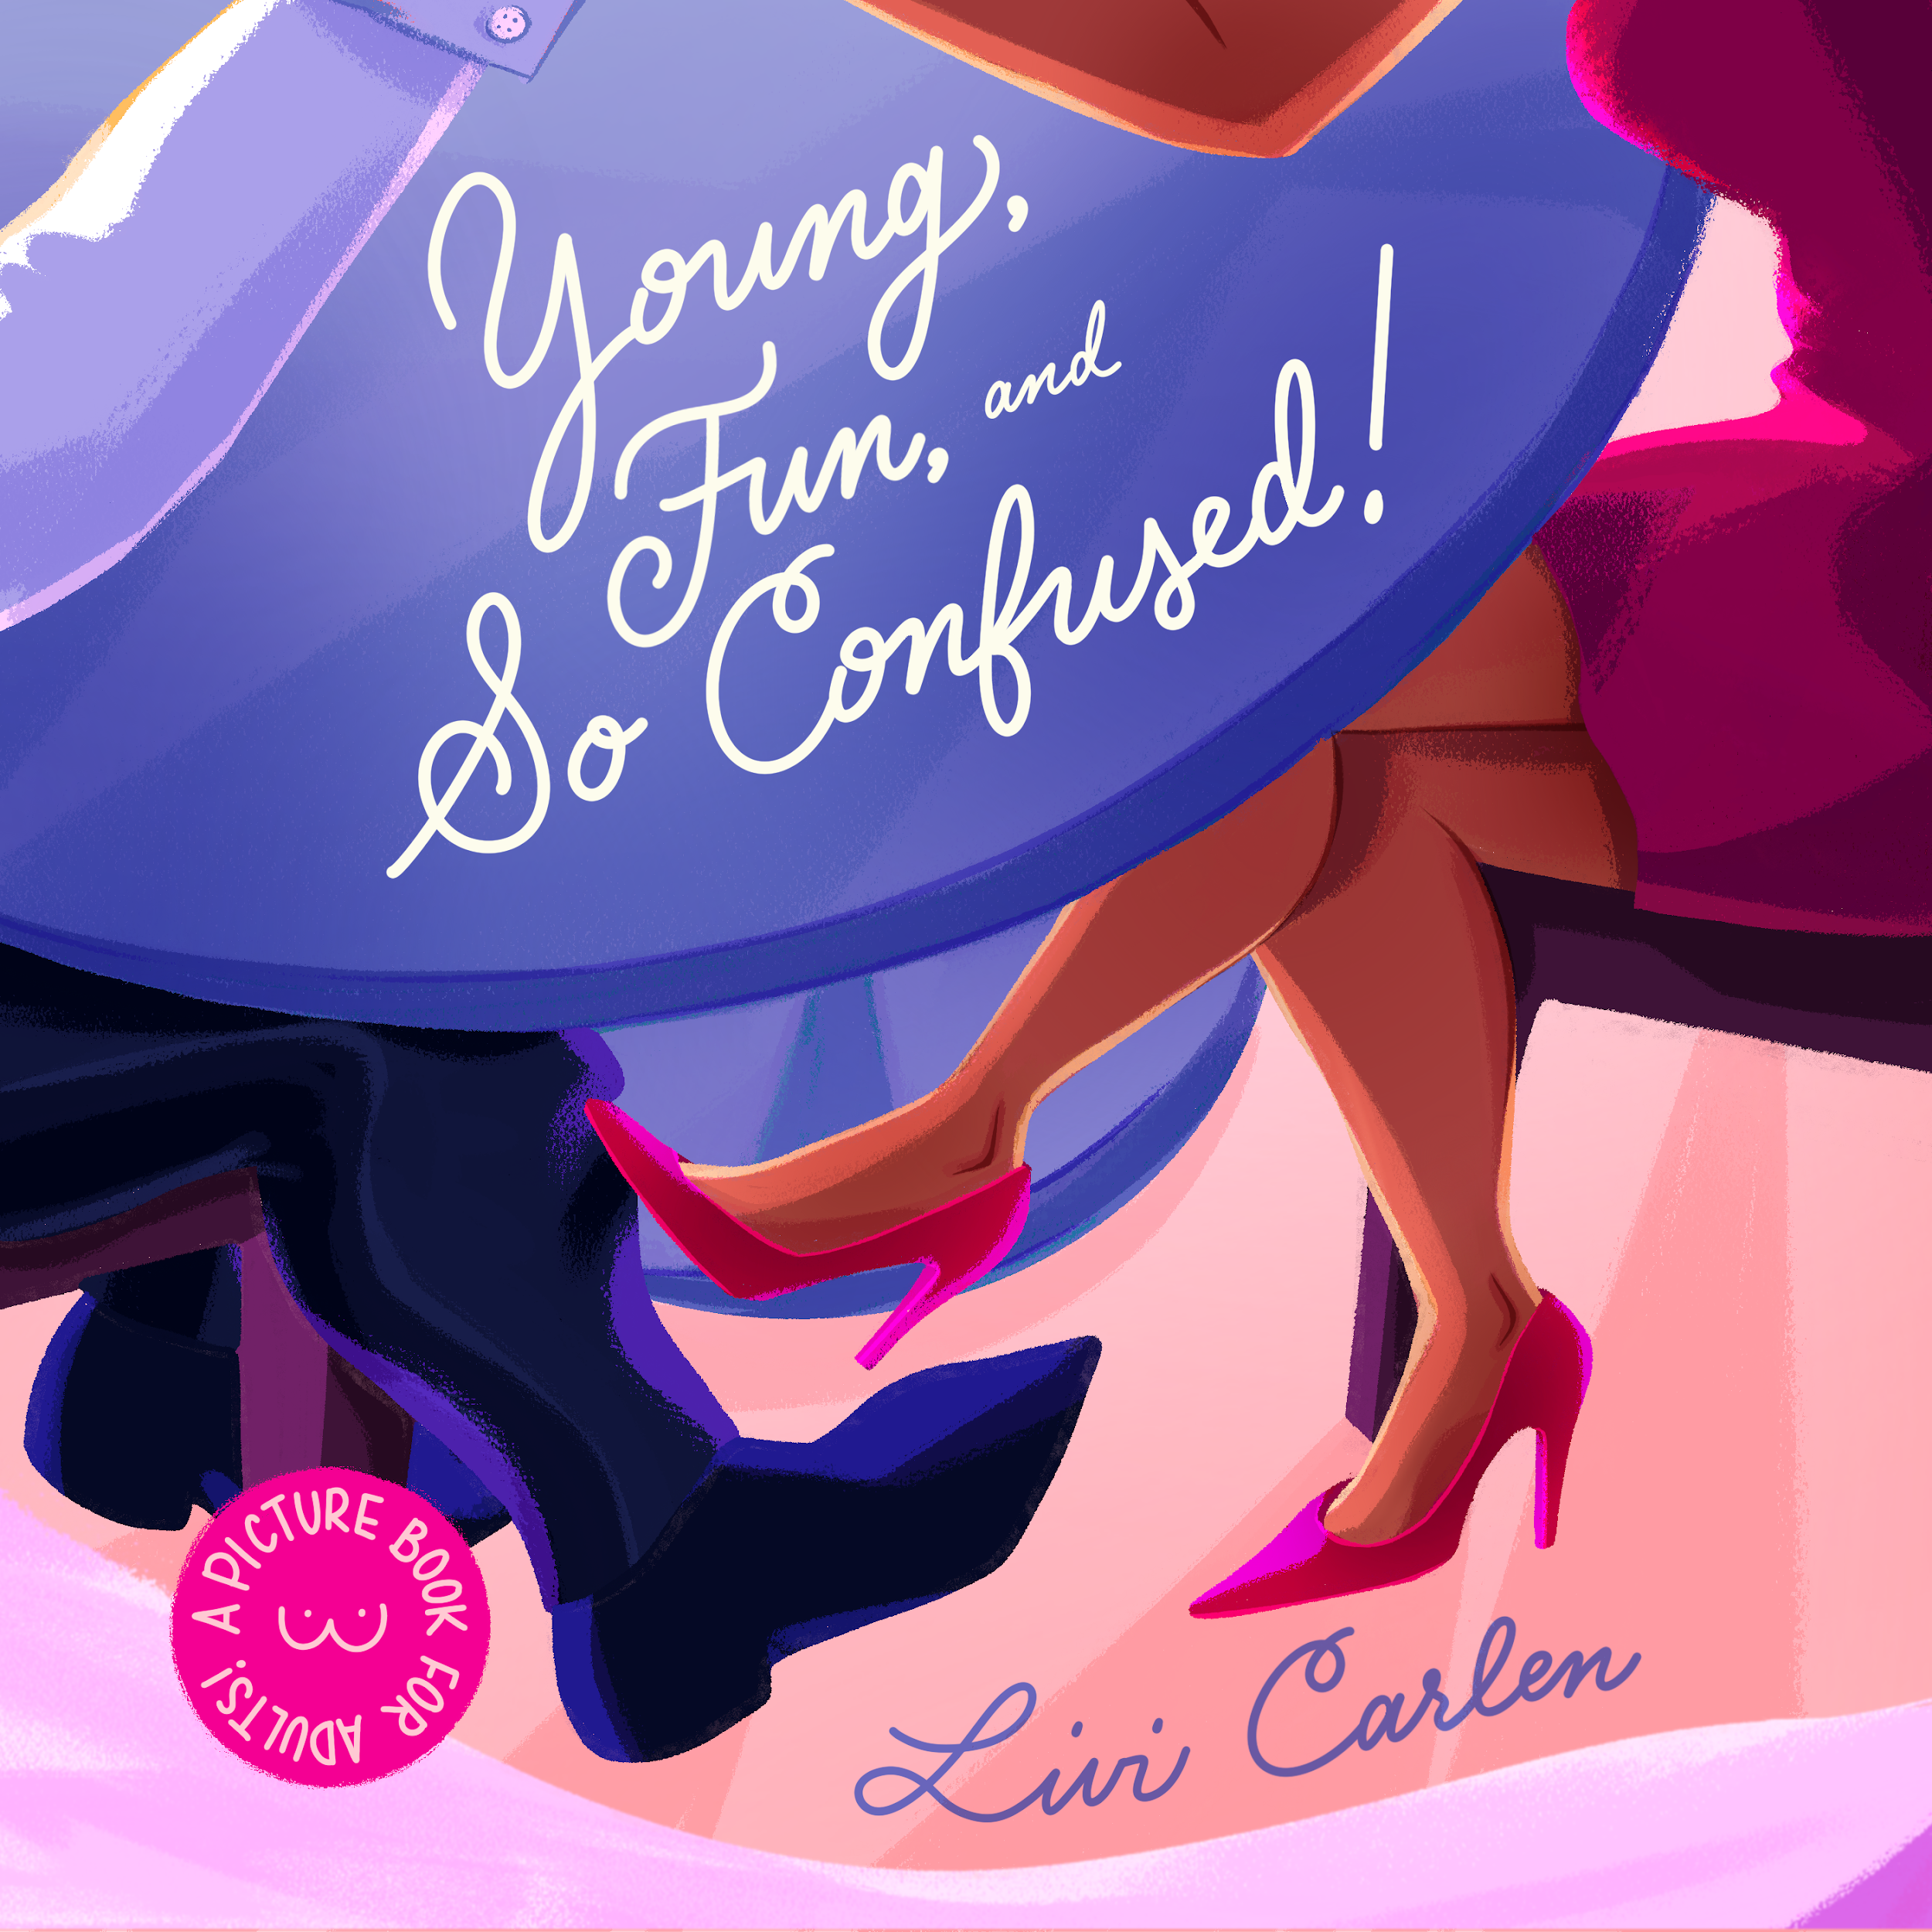
Young, Fun, and So Confused!
Young, Fun, and So Confused!, is a coming-of-age, romantic comedy, story about the life of a girl dating in her twenties. It is a 56-page rhyming picture book marketed for adult readers, because grown-ups deserve the beautiful illustrations of picture books, too!
Dating was a new and big aspect of my life when starting my visual thesis journey. The experience felt like a satire, but I met interesting characters that I felt needed to be shared with the public because of how relatable they were. I believe everyone who dates will encounter at least one of these: Lothario, Boy-Next-Door, Art Boy, and Friend.
In addition, I found the experience of dating online to be reminiscent of taking library books out. With that being said, each character is a new book I pick out from the library-of-love!
This thesis also marrys my two art styles for a full circle art identity. My linear style represents the present time-“line” and reality, whereas the full render style evokes the animated feelings of first dates.
Detail of one of your images

Slide 3
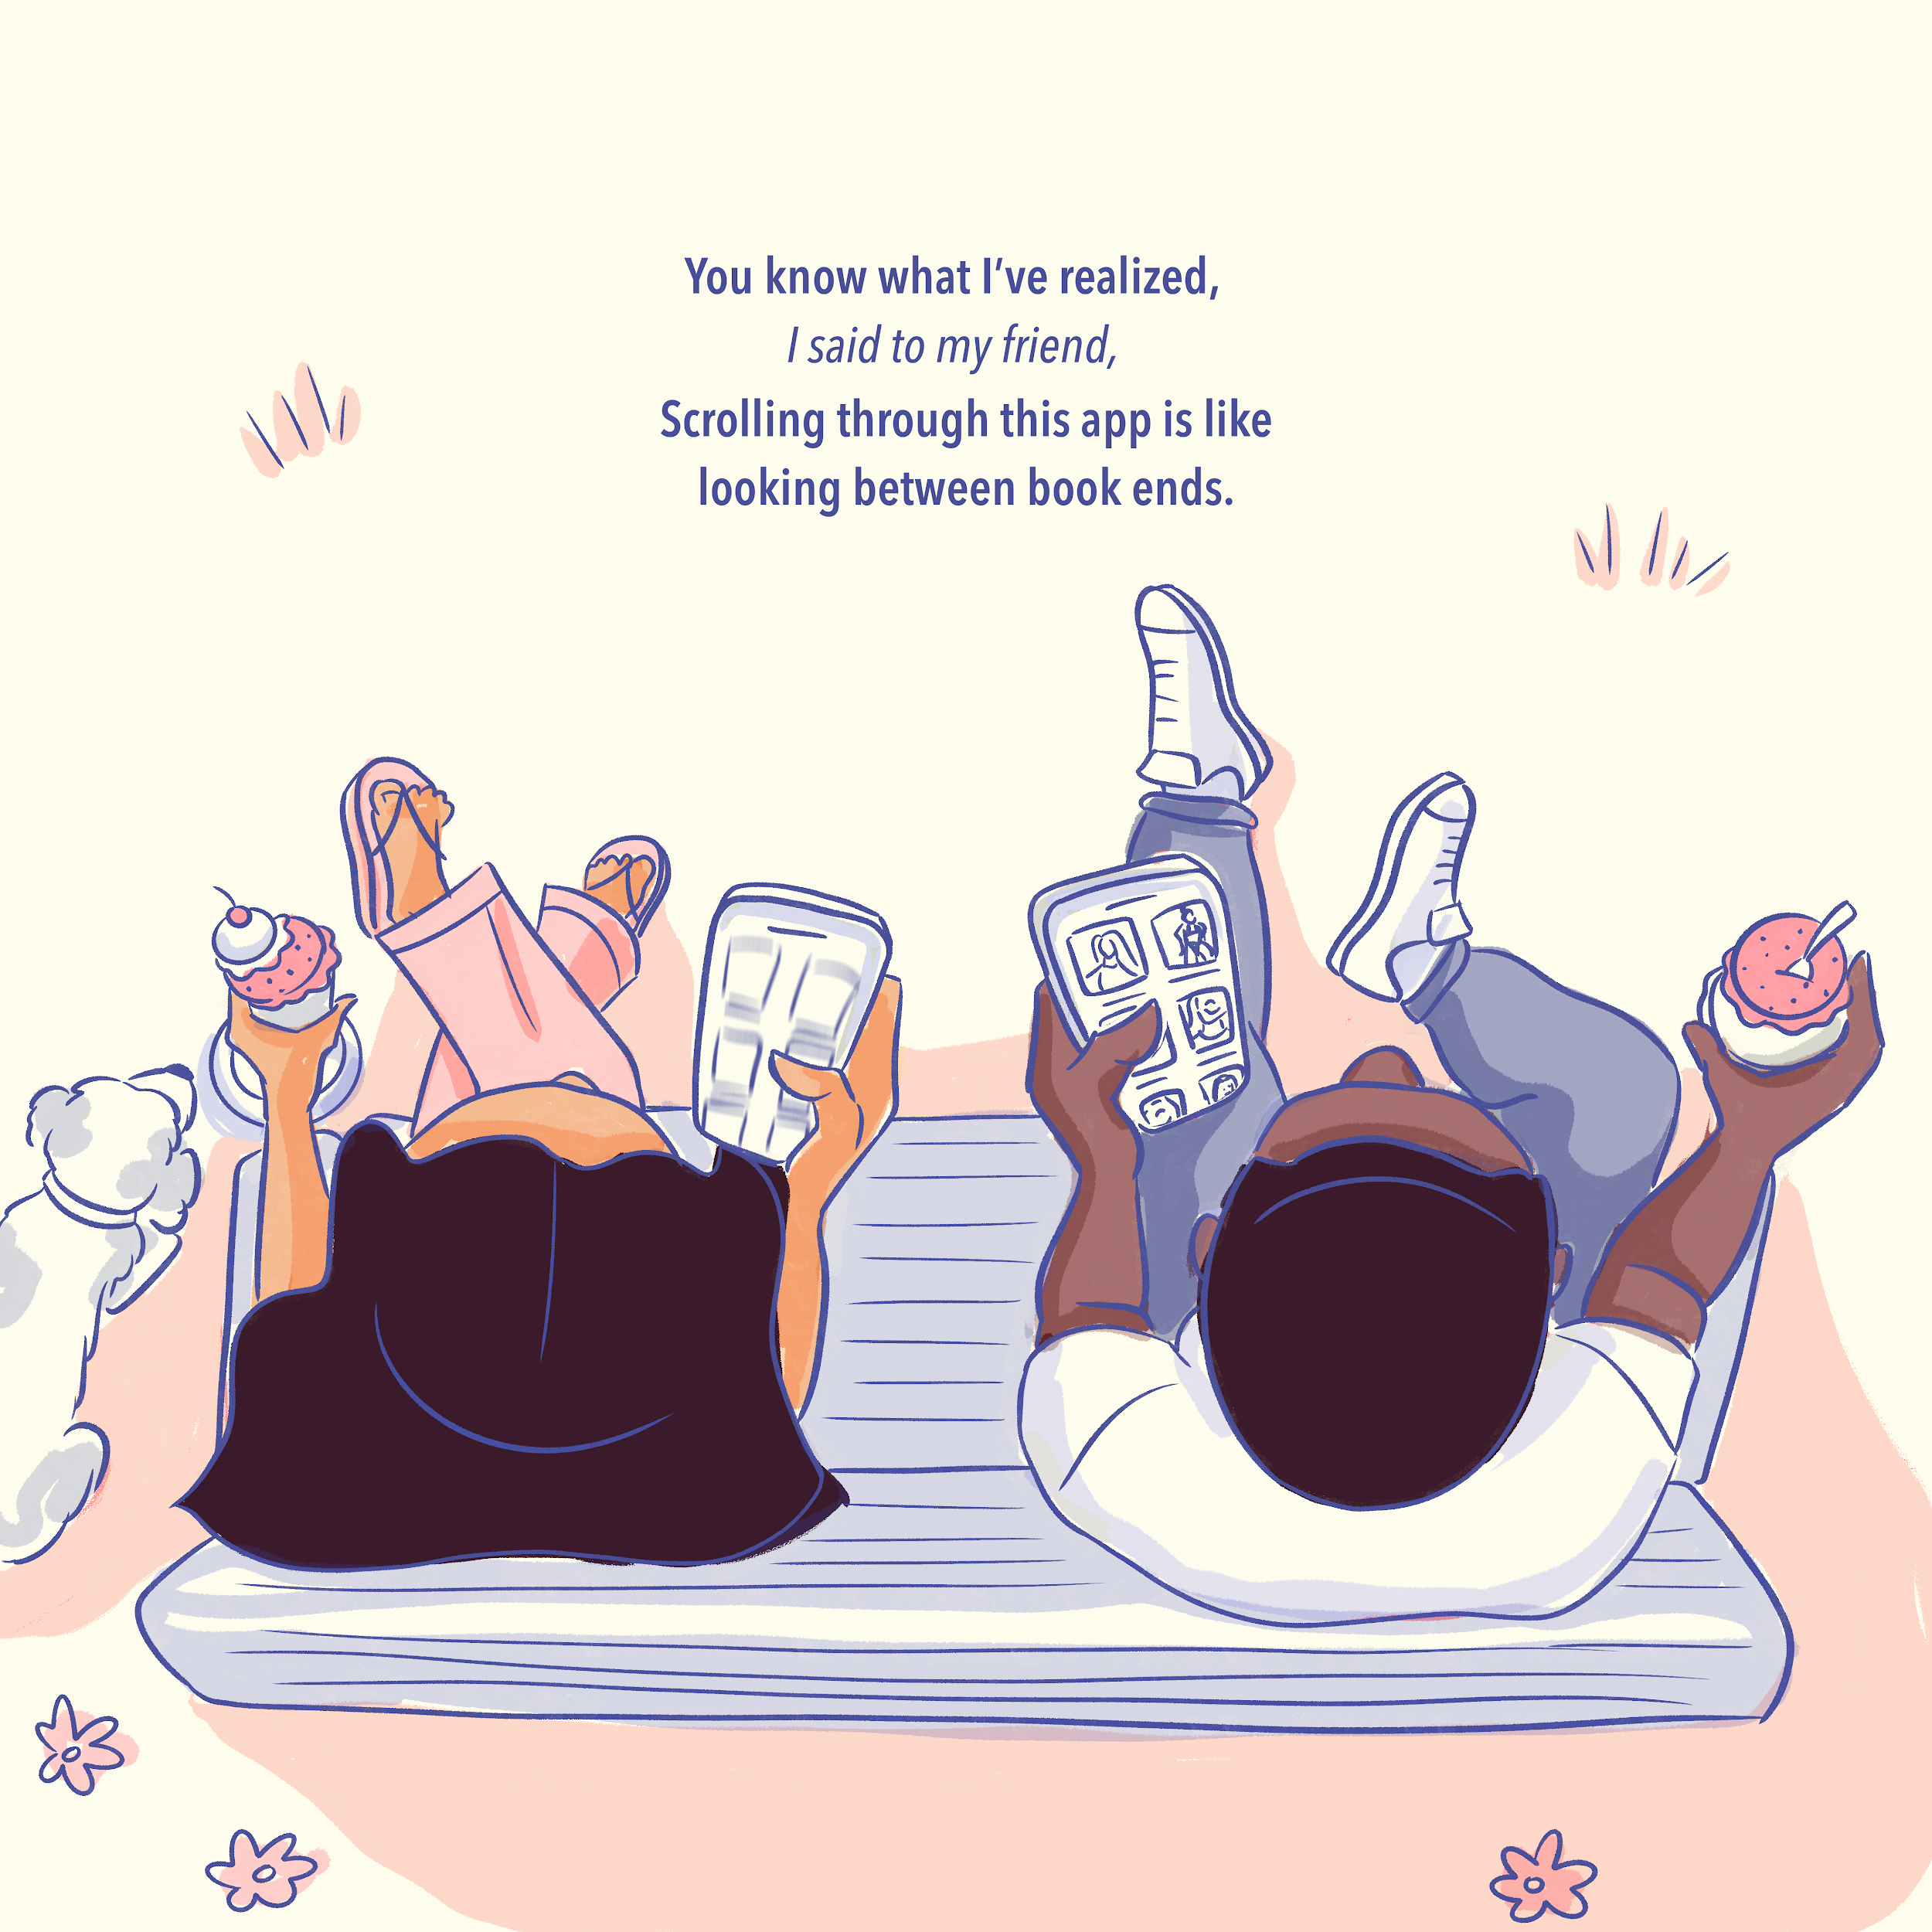
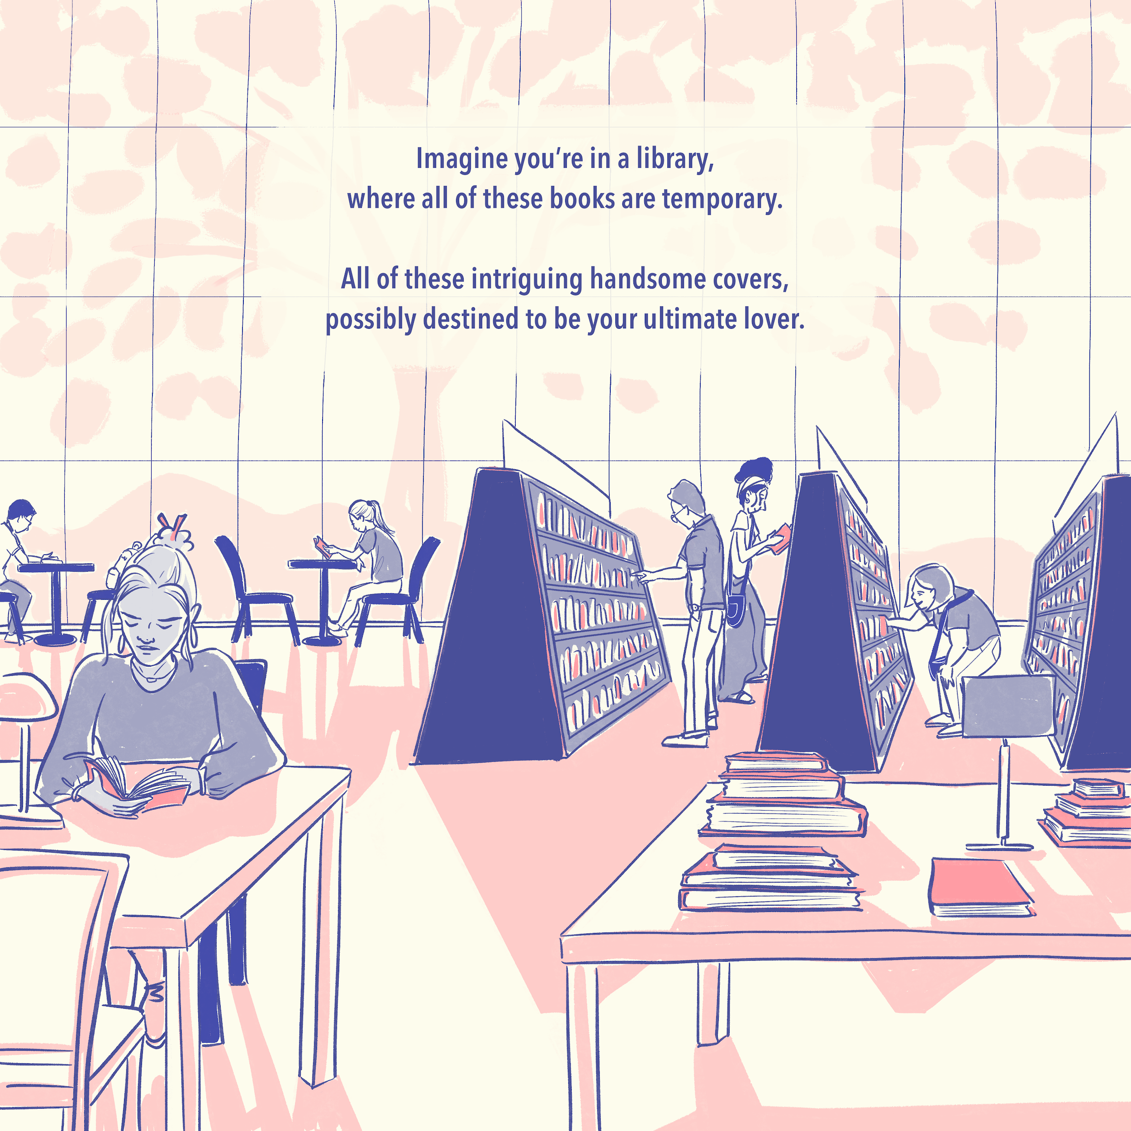
Final Art Sample 1
Intro
Digital Print
6” x 12”
Linear art style creating foundation for book’s world.

Slide 4
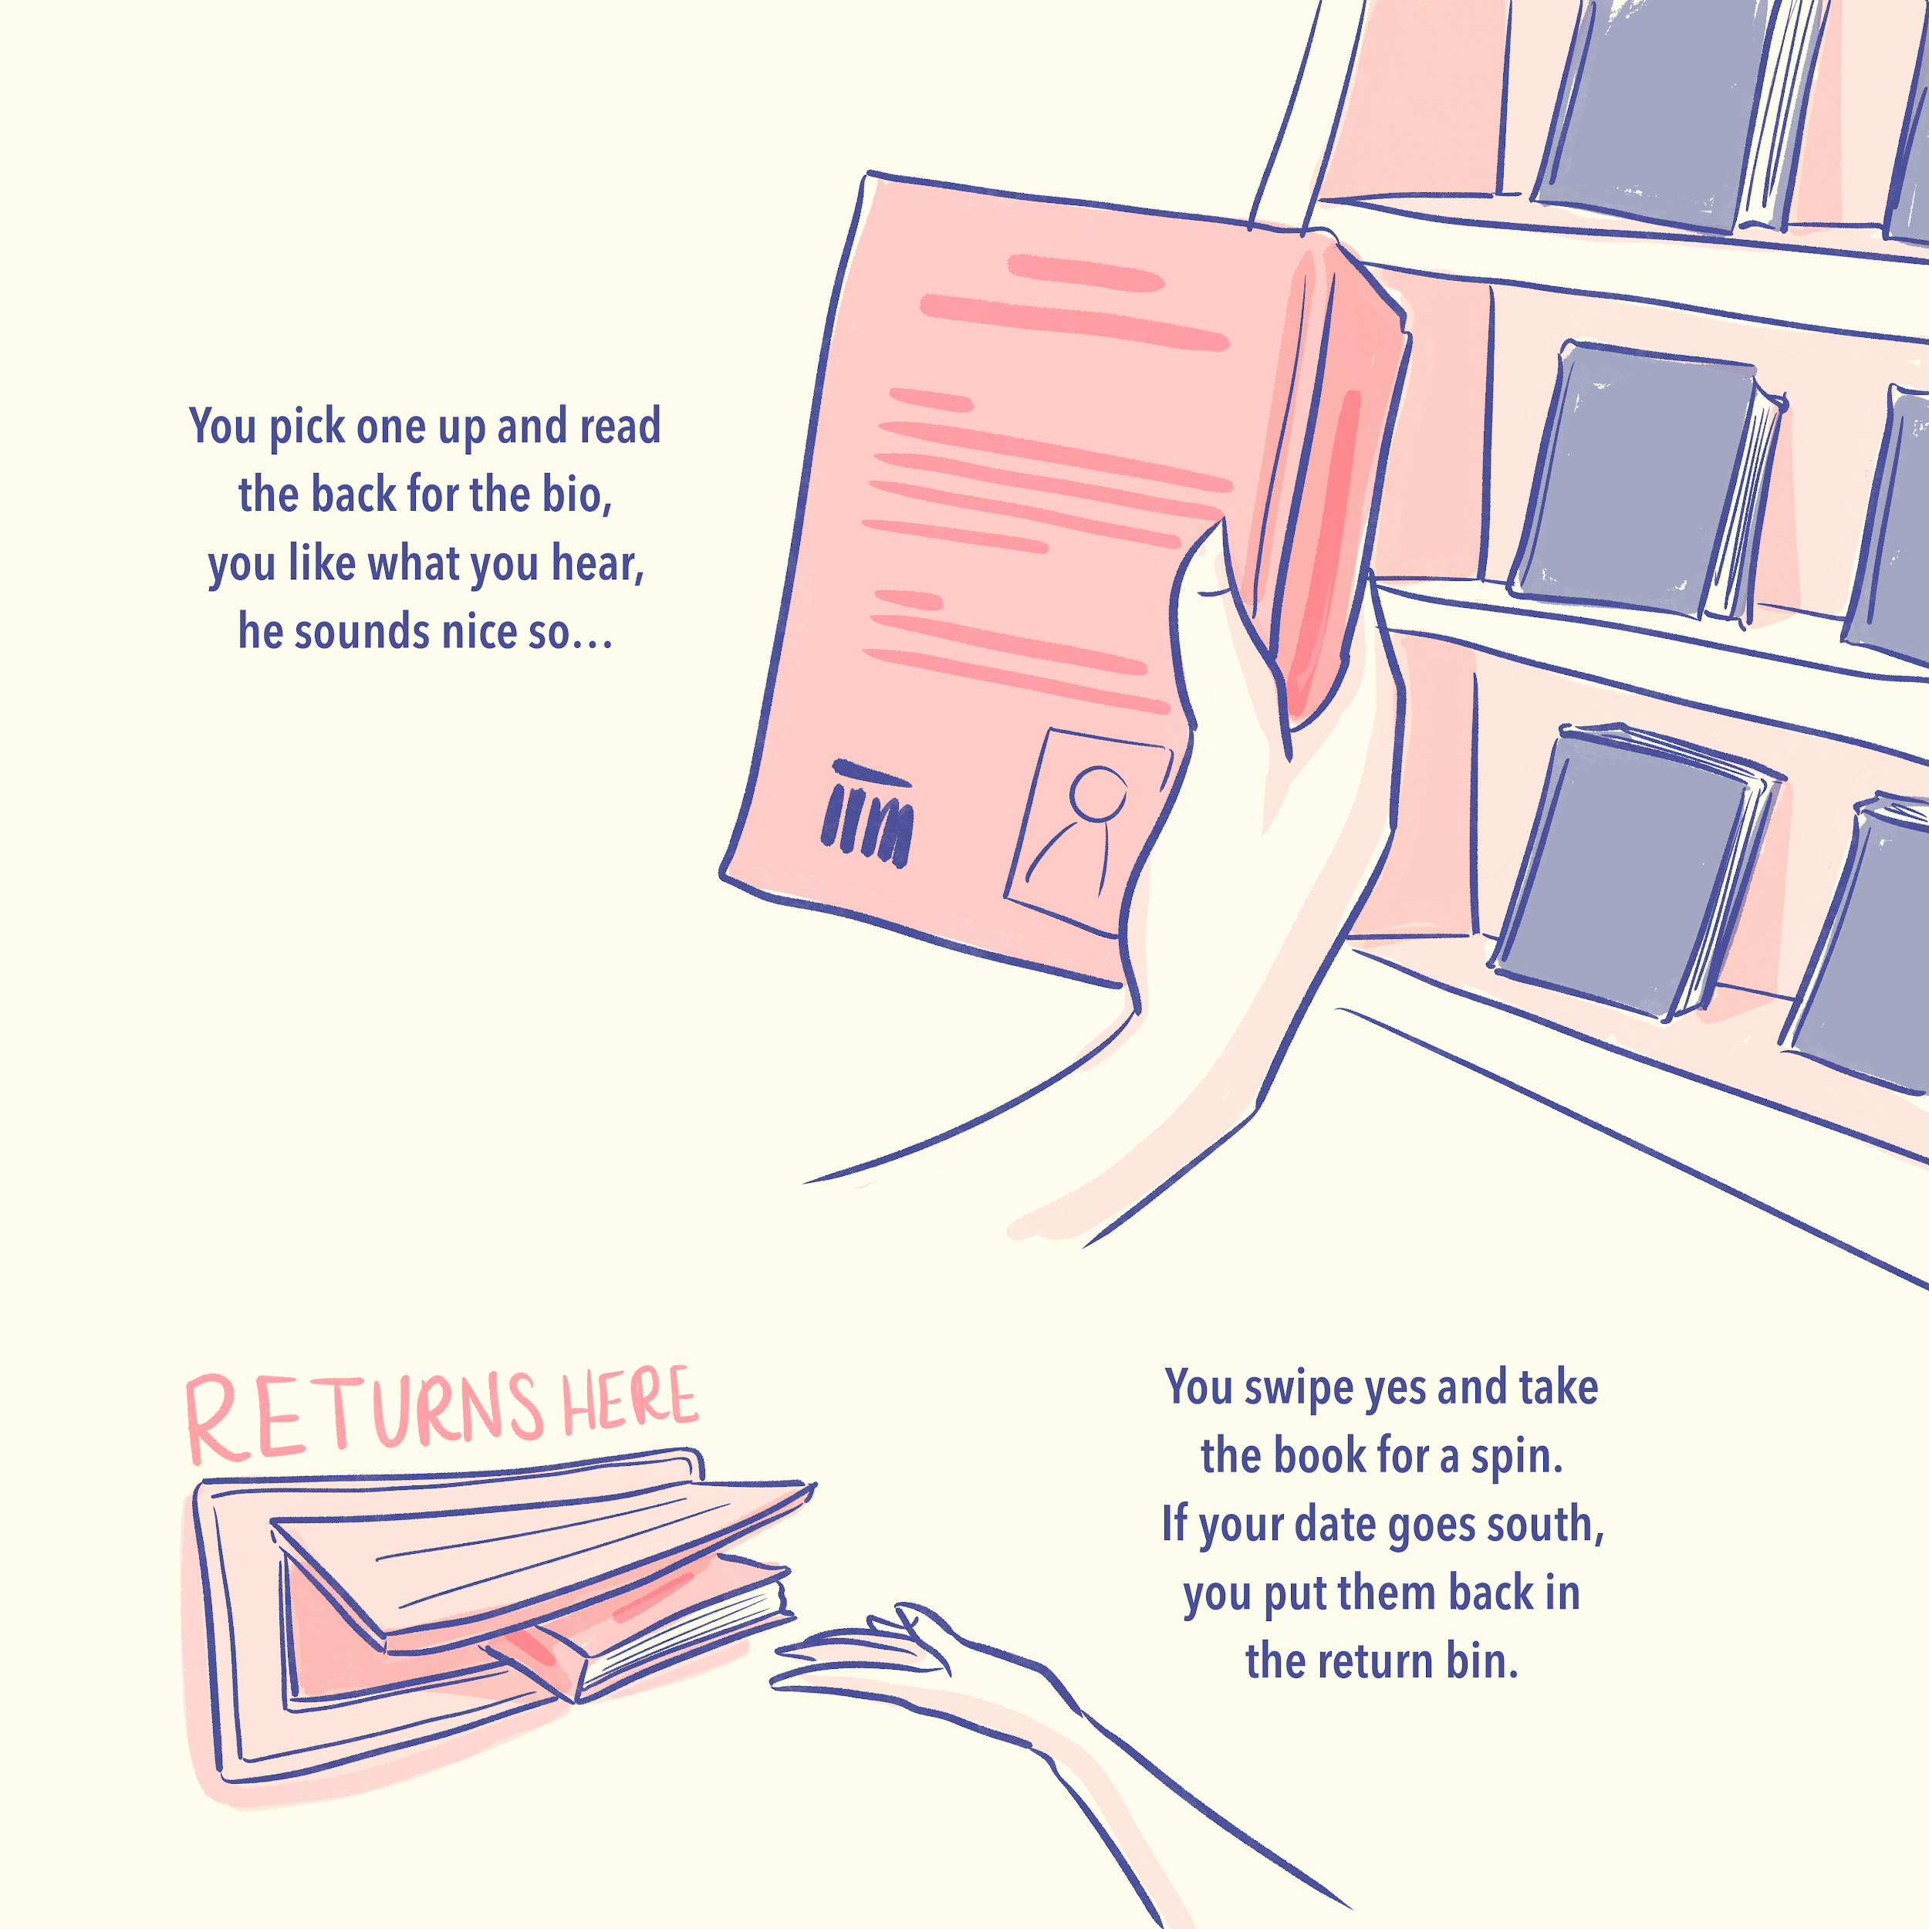
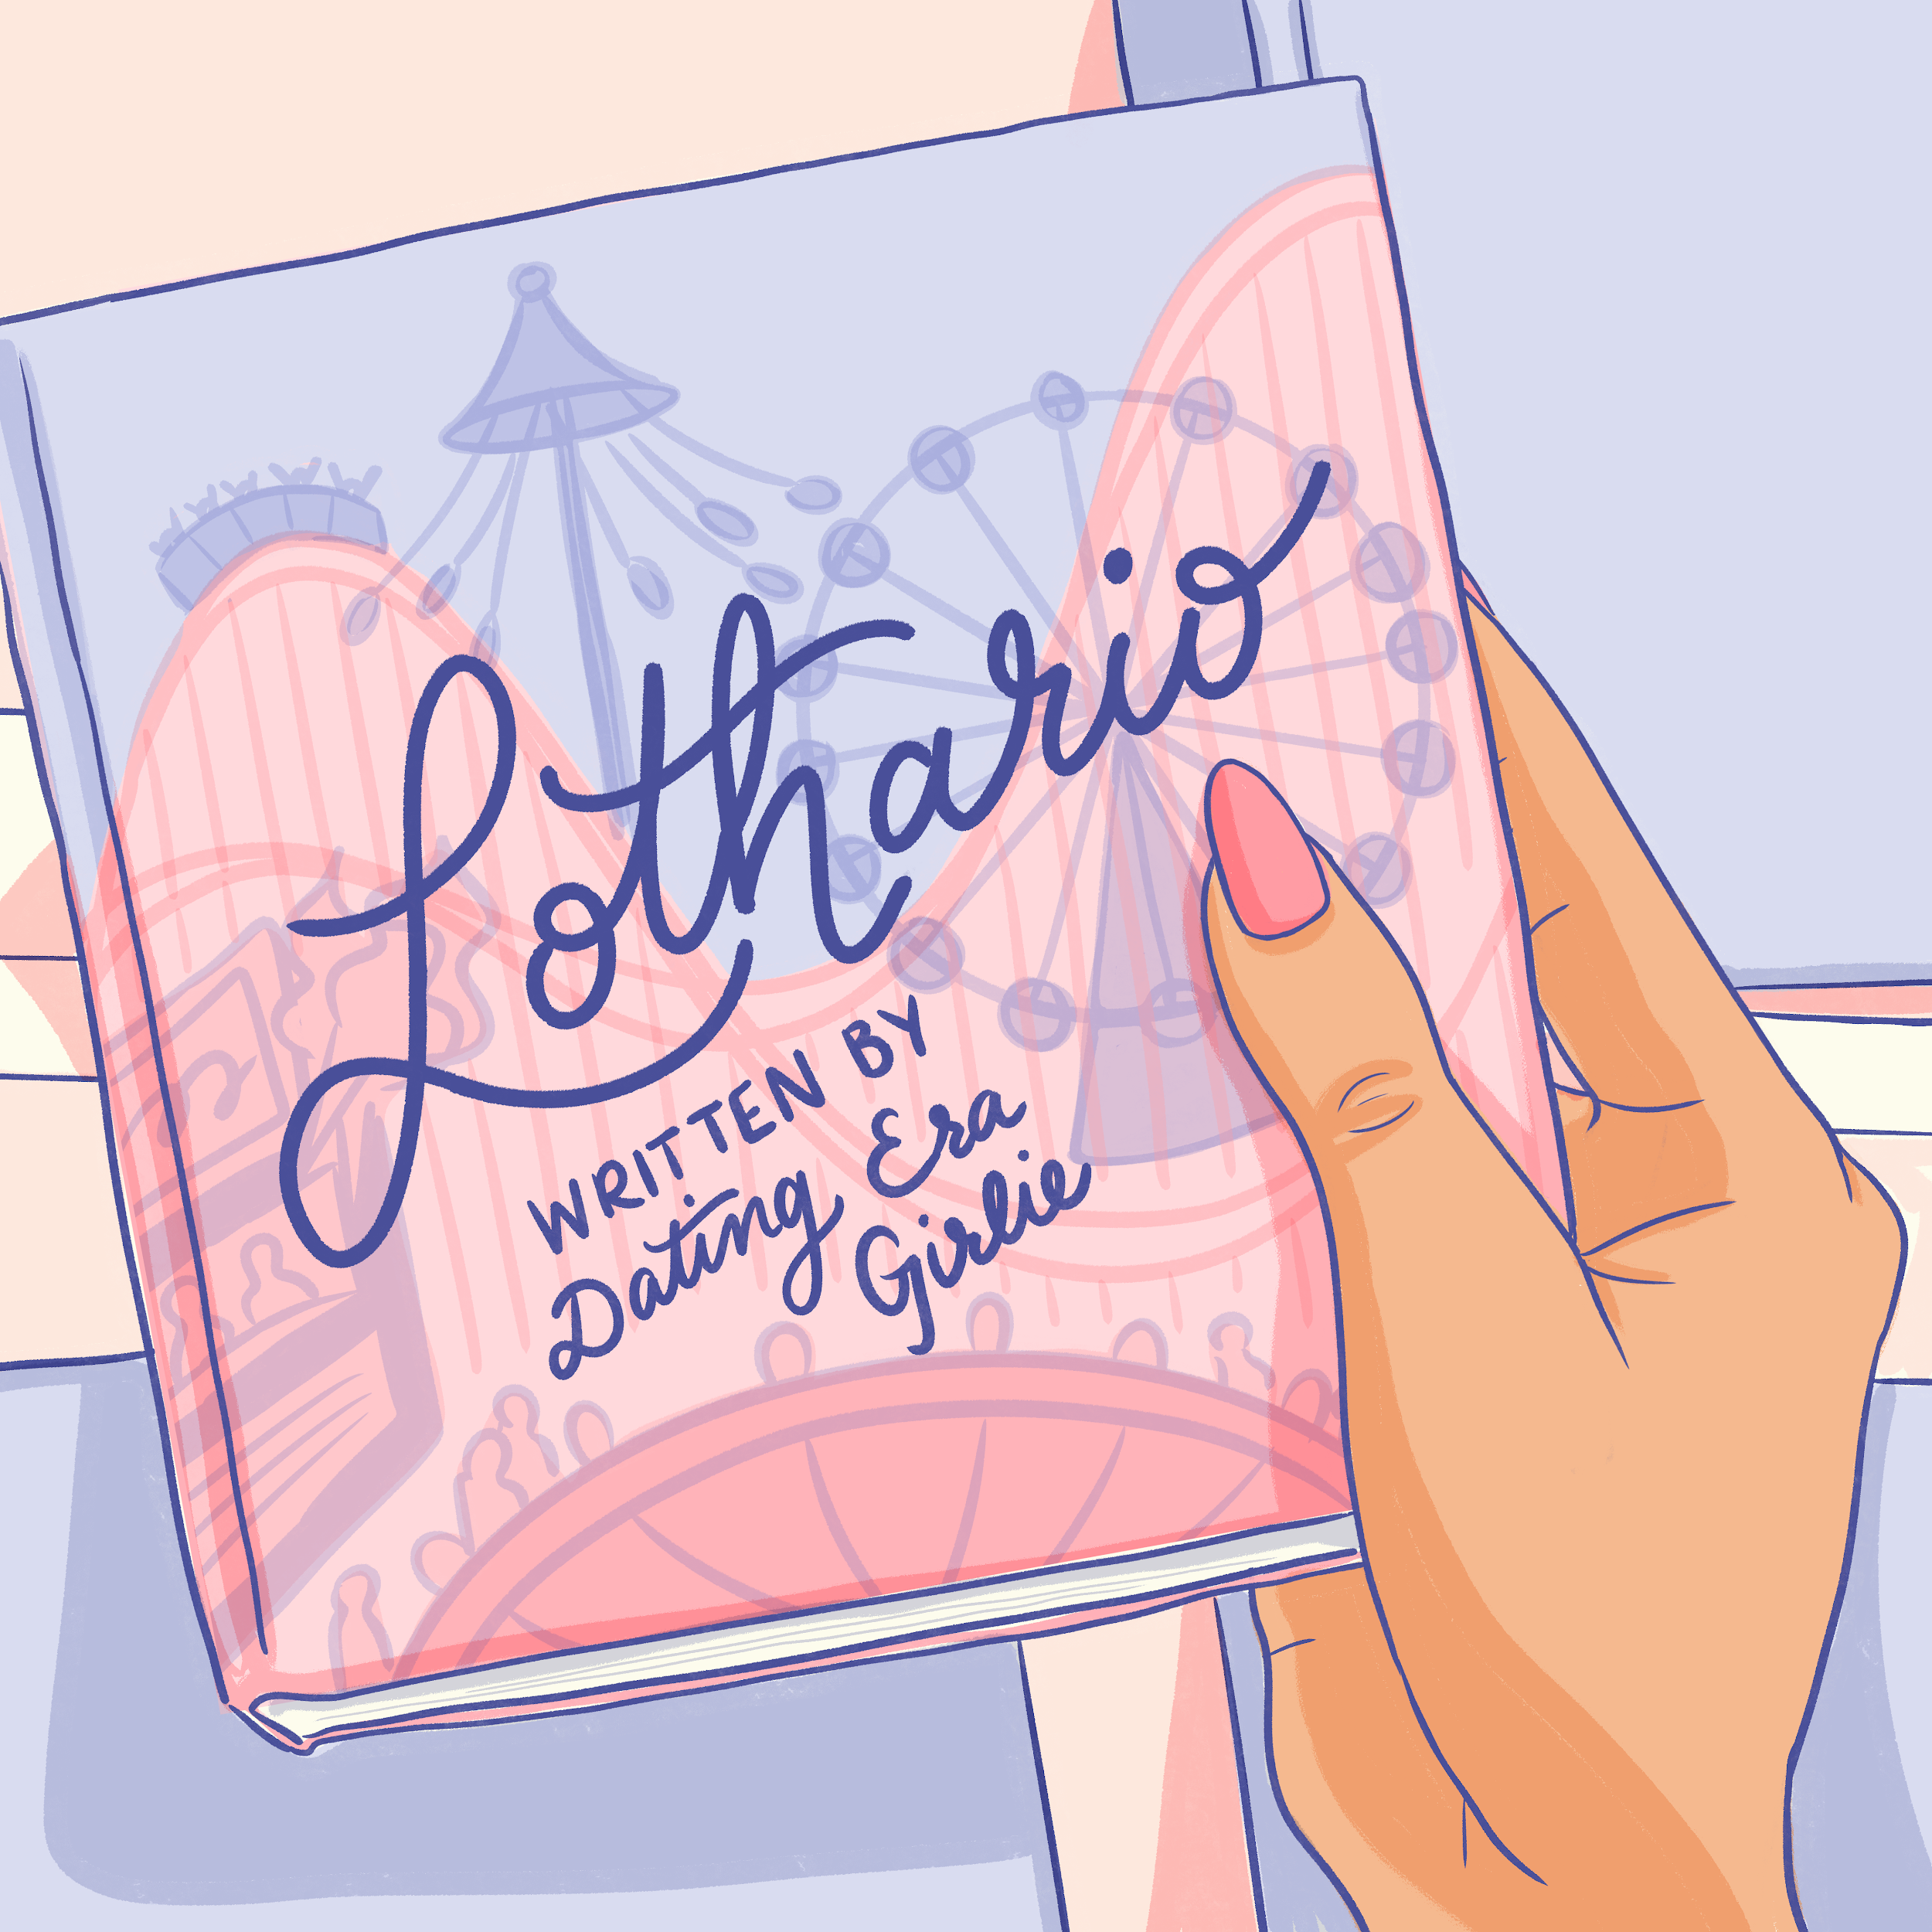
Lothario Chapter Cover
Digital Print
6” x 12”
Each chapter is a new suitor/date to read about.

Slide 5
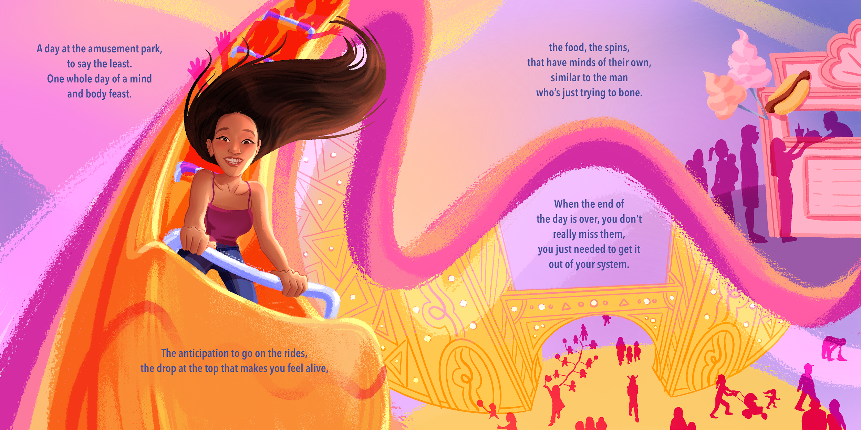
Final Art Sample 1
Lothario Chapter
Digital Print
6” x 12”
Retelling my dates or thoughts in full render art style to differentiate from real life.

Slide 6
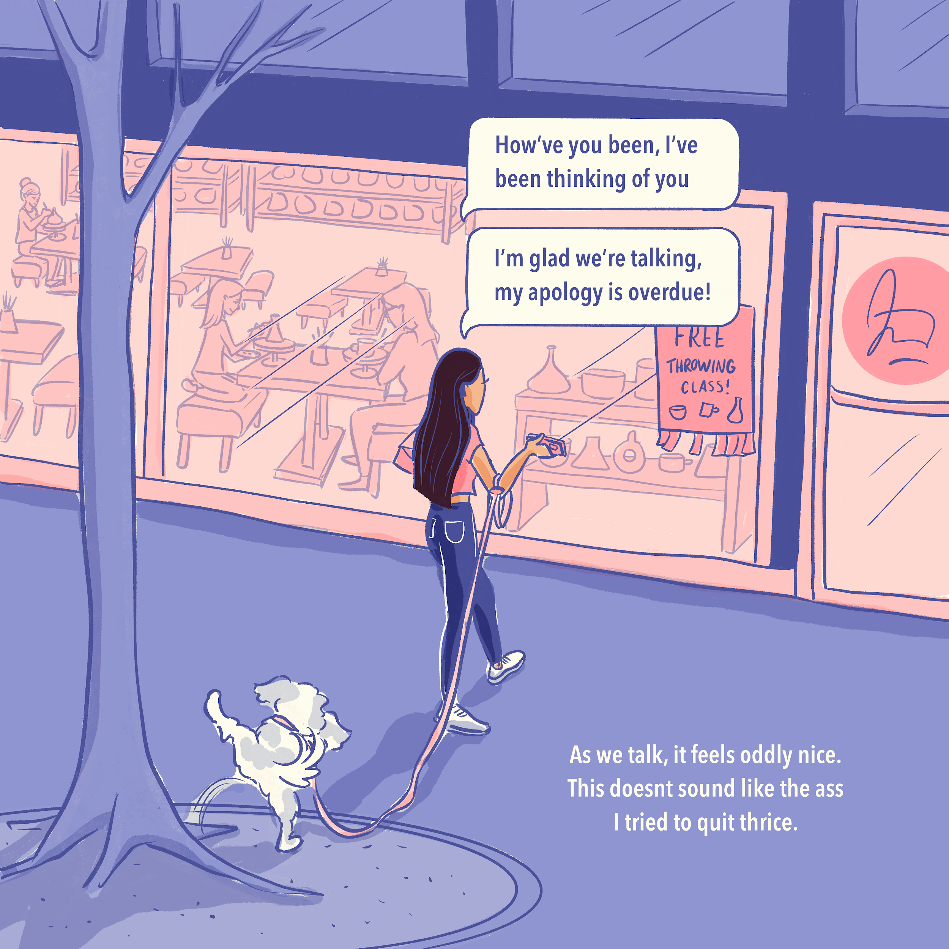
Boy Next Door Chapter
Digital Print
6” x 12”
Introduction to another date using linear art to depict present time.

Slide 7
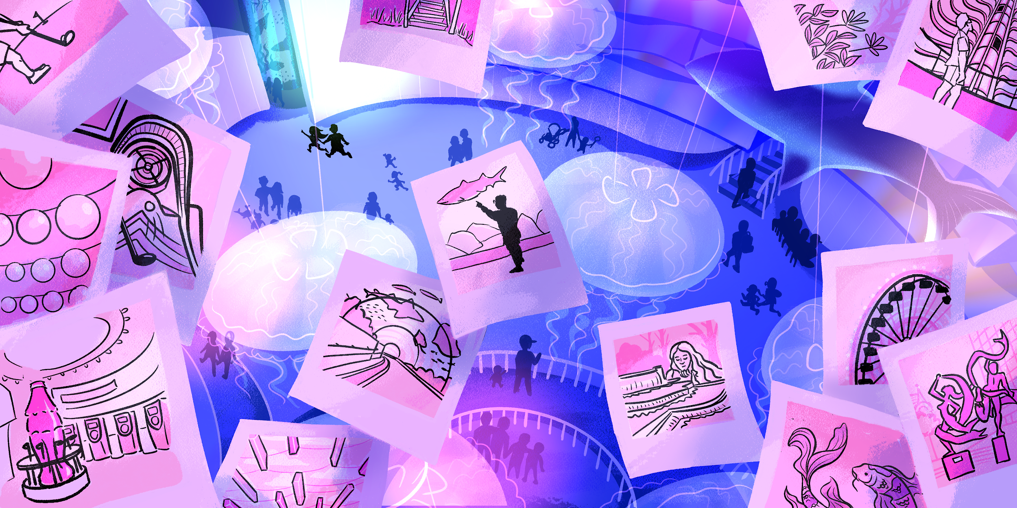
Final Art Sample 1
Boy Next Door Chapter
Digital Print
6” x 12”
Spread recounting my date in full render art style.

