Slide 1
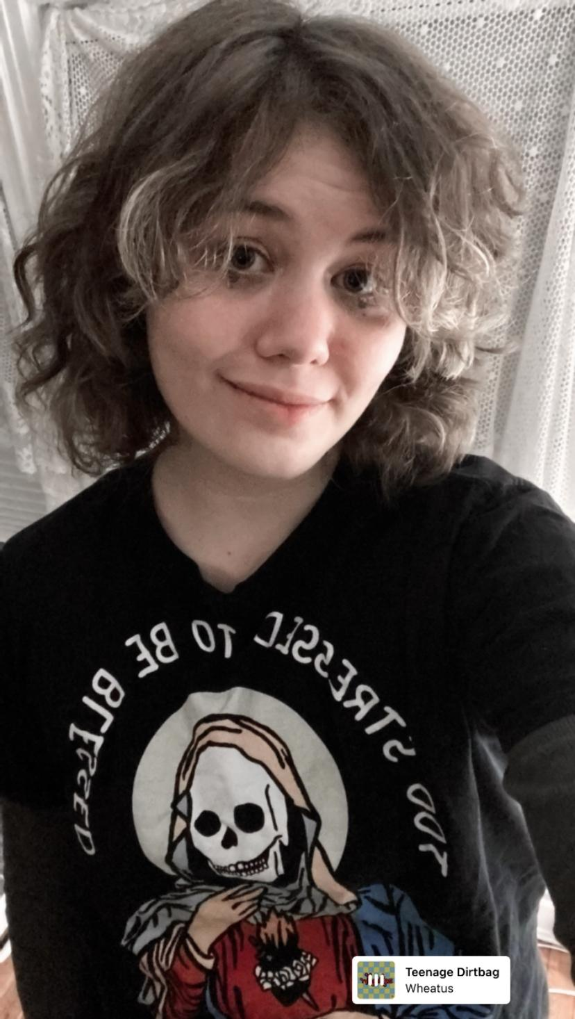
Izzy Singer
I am an illustrator/comic artist/animator born and raised in NYC. My comics and illustrations have been published in literary magazines since 2021. I work with traditional media (color pencils, inks, dip pens, and paints) and digitally. I have a background in animation and like to use movement and color in my illustrations. My comics largely center on fantasy, urban life, memoir, the environment, disability, and horror.
Web: www.izzysinger.com
IG: @izzybleep
Email: artisticizzy@gmail.com

Slide 2
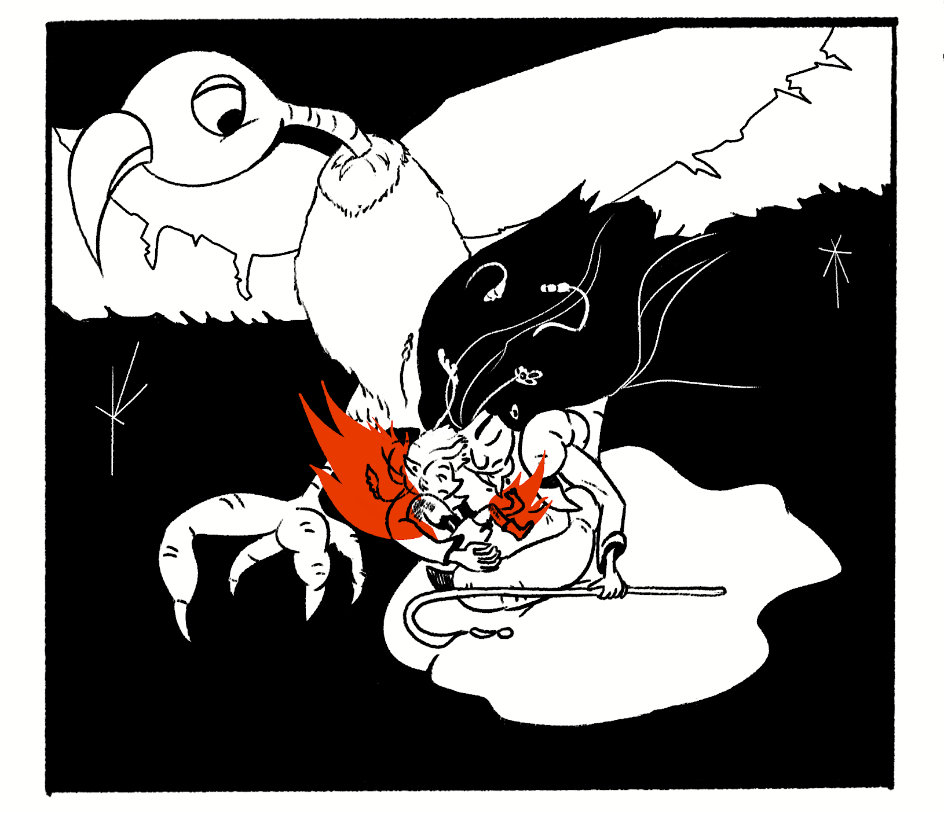
When The Sun Shines
These three chapters of a follow a Hay Pixie who falls out of the sky…but before I continue what exactly is a Hay Pixie? Well, a hay pixie is a human-sized magical being who can grow plants in their hair, have the power to control wind currents and love mischief and storytelling. In the hay pixies’ case they grow the plants which make up hay which includes many kinds of grasses, clovers and legumes. They are nomadic and are known to help farmers who treat them kindly. In this story, however, it seems they are missing, all except for the pixie child in our story, who fell out of the sky.
This is the first three chapters of a Fantasy/Adventure comic which seeks to introduce the reader on a journey into another world where pixies, knights and witches live in chaos. But it will not be as you might expect. The witch will be complicated and kind, the knight will be cursed and bratty, and the pixie will be a child like any other… with the ability to shift wind currents and grow grass, clovers and legumes (the plants that make up hay) out of her head. It is not a fairy tale but a pixie tale.

Slide 3
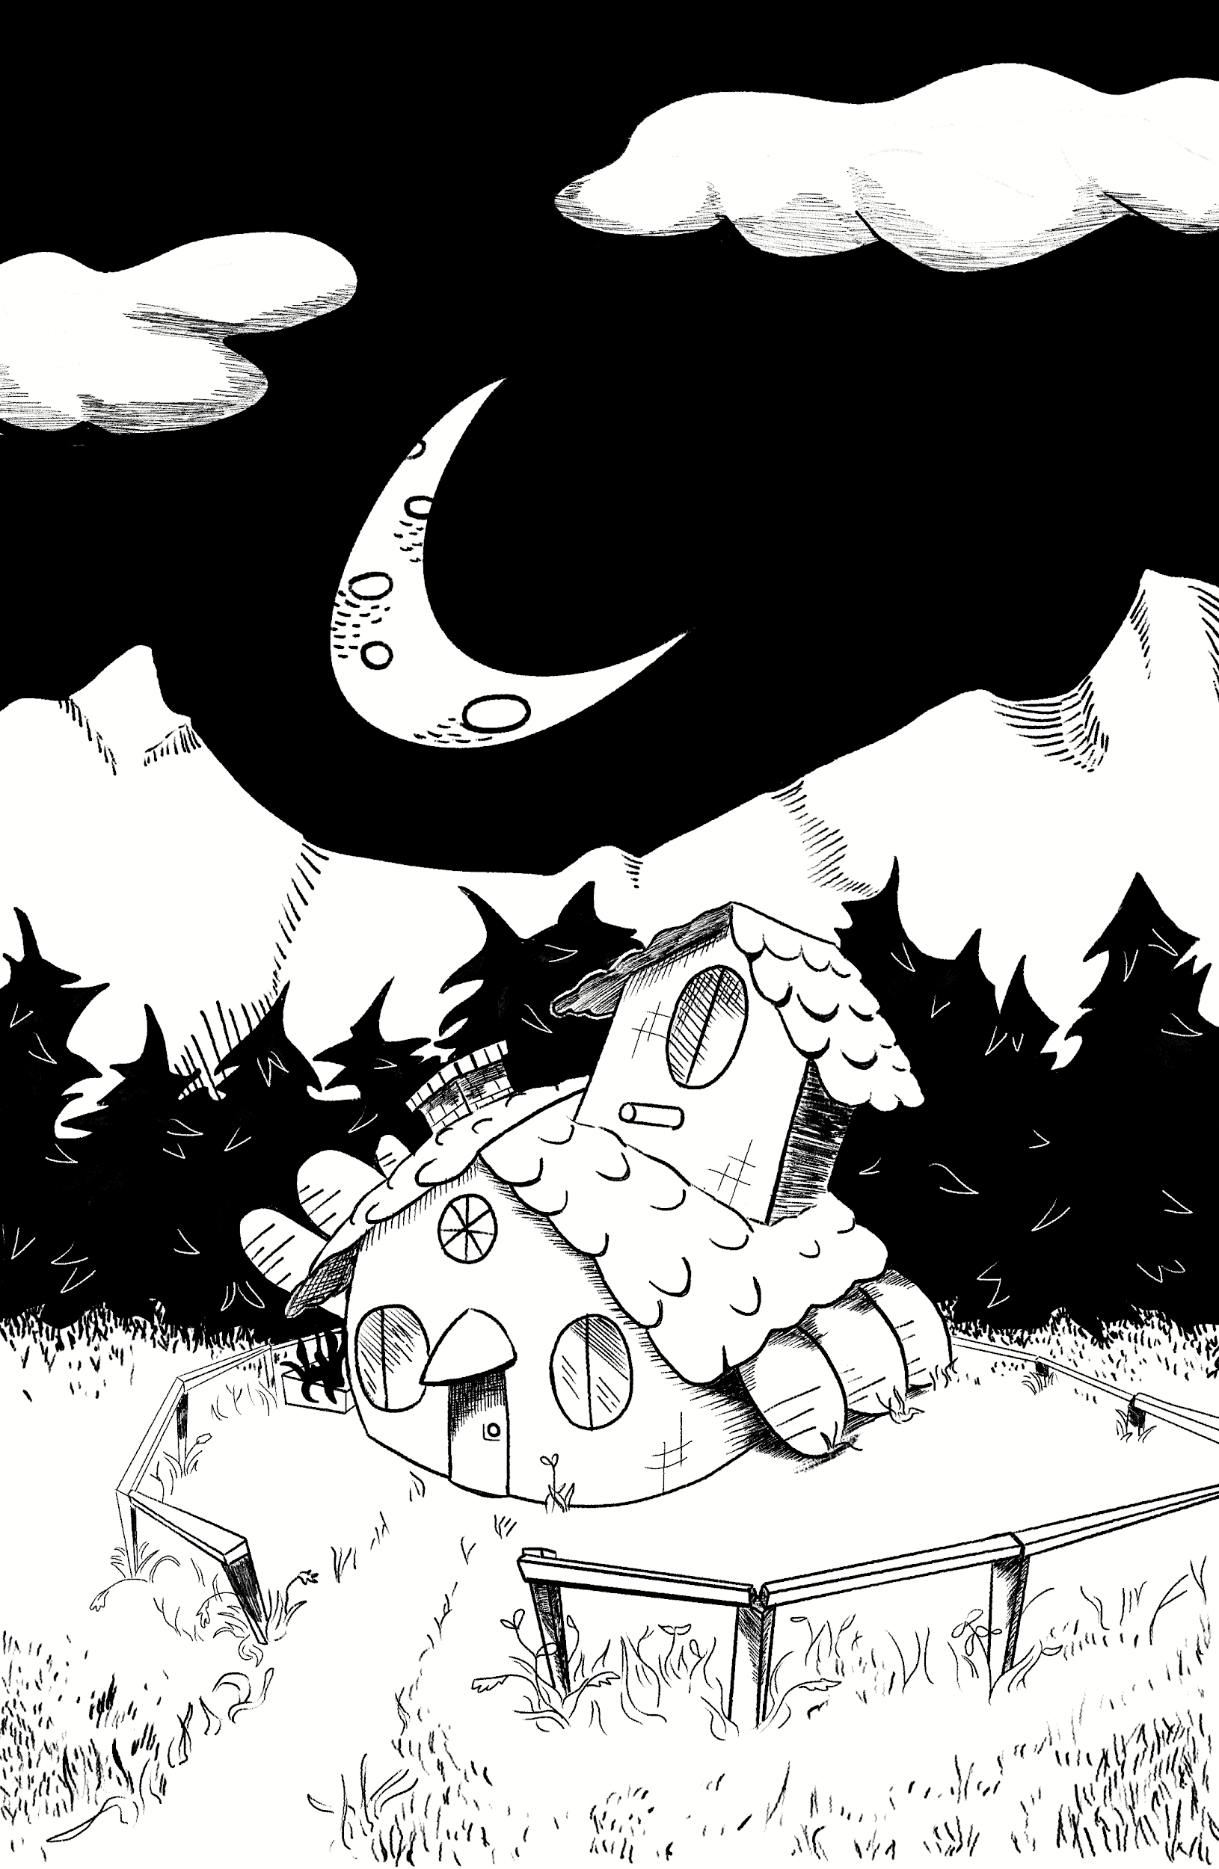
Page One
Digital
7.5x11.5

Slide 4
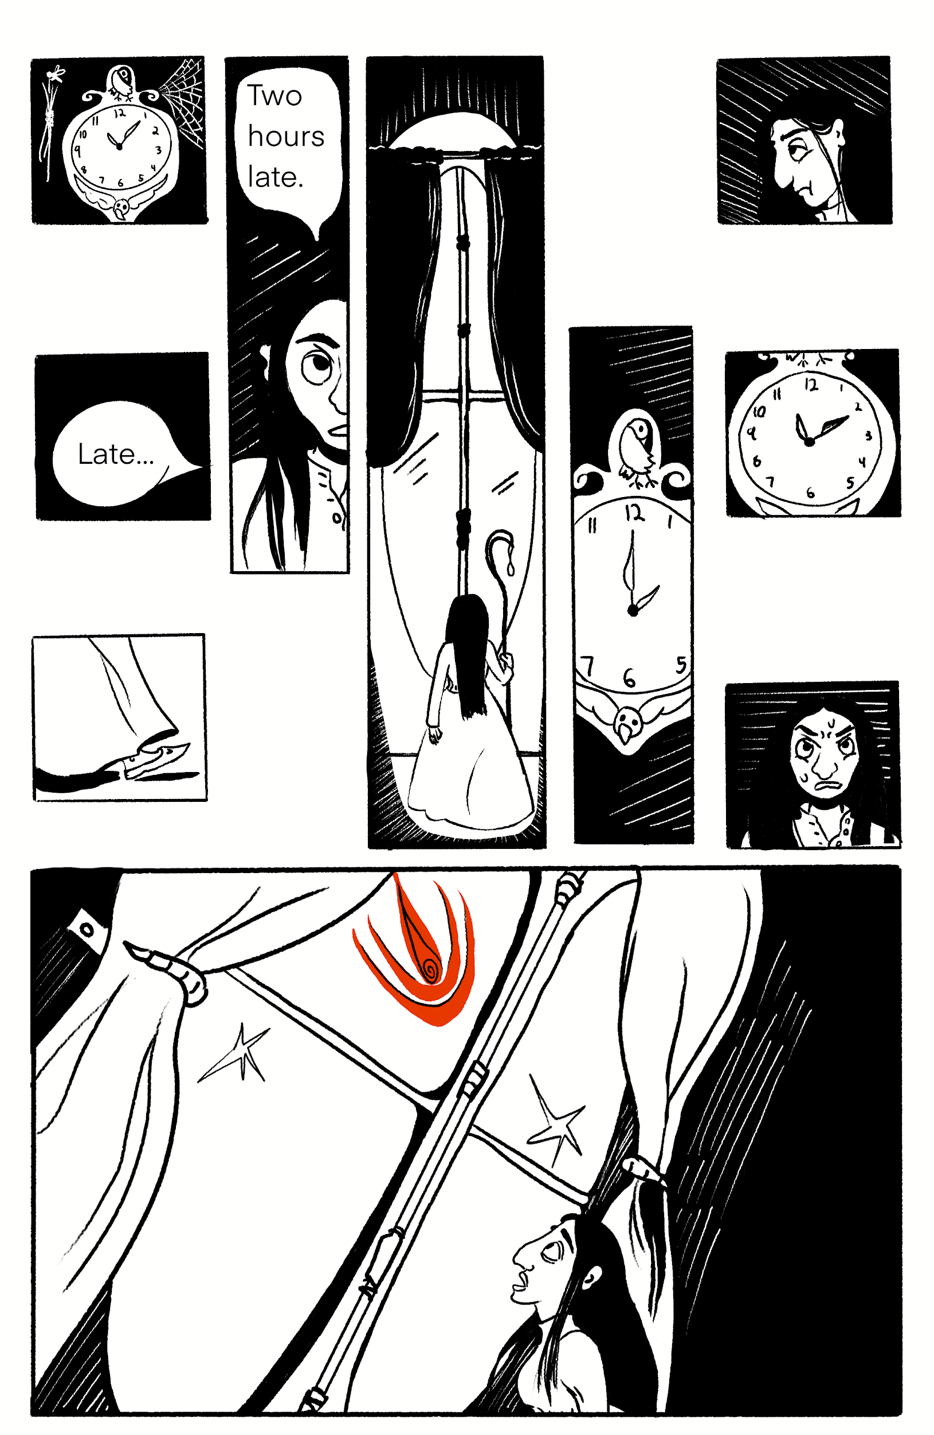
Page Two
Digital
7.5x11.5

Slide 5
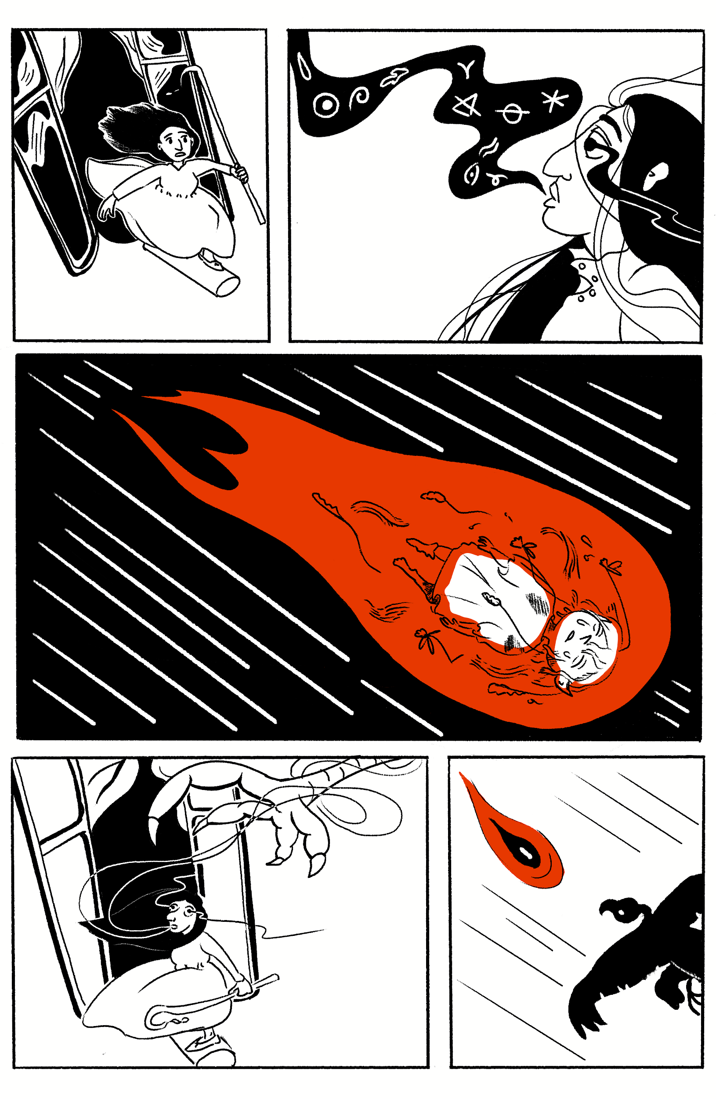
Page Three
Digital
7.5x11.5

